Slide 1
GPU-ORIENTED ALGORITHMS for
continuous energy monte carlo
neutron transport
gavin ridley
Advisor: dr. benoit Forget
August 13, 2024
AALO ATOMICS

Slide 2
Outline
  Part 1) Introduction
  Part 2) The First Published GPU-Enabled Version of OpenMC
  Part 3) A New Resonant Scattering Sampling Algorithm
  Part 4) A New Unresolved Resonance Modeling Technique
(Sub-outlines will be within each)

Slide 3
Part one
introduction

Slide 4
part 1 overview
  Reactor physics primer (8 slides)
  Monte Carlo neutral particle simulations (5 slides)
  About GPUs (7 slides)

Slide 5
why nuclear power?
Consensus since circa 100,000 BC:
We seek energy that is:
  Affordable
  Reliable
  Won’t harm people
  Won’t harm environment
Energy is good.
Source: The Far Side
Notes:
These guys were thinking about how to extract energy from wood.
Today we’re going to talk about extracting energy from uranium.
PhD defenses are weird... you’ve become an expert on the bleeding edge of science, and your advisor and maybe a handful of other people are on the same page as you. 90% of the people here just want to learn a little about what that cutting edge is, so there’s a balance to strike between showing my novel contributions and explaining the context fully. Tricky!!
“Fire not economical, will never ...”

Slide 6
nuclear fission chain reactions
Figure: MIT nuclear reactor core, source nrl.mit.edu
Notes:
Load uranium in some fashion into a pile
Chain reaction may or may not commence. It might run away, die out, or stay constant.

Slide 7
One way to make a reactor
Image: US NRC / Creative Commons
Pack uranium in some form into fuel rods
Arrange rods into a bundle
Load bundles into a reactor
Furnish some means of removing heat, for example by pumping water across the rods
Turn a turbine using the heat from the fuel
Photo: Kernkraftwerk Gosgen-Daniken AG / Creative Commons

Slide 8
reactor physics
Where are
the neutrons?
Ultimately, what is the role of a reactor physicist?
Predict and control the reactor’s state in normal and off-normal conditions
This may encompass:
  Source term calculations
  Depletion analysis
  Transient analysis
  ...
These analyses are underpinned by a unifying question...
(redacted)
Figure: A reactor design and some heatmaps showing neutron fluxes.
Notes:
i.e. what the flux?

Slide 9
reactor physics
Q: How do we predict where the neutrons are?
A: Neutron transport theory
Inputs to neutron transport equation:
Nuclear/molecular physics data
Material composition
Geometric layout of materials
Some possible outputs:
Neutron fluxes at every energy or point in space (or time)
Transmutation rates of materials
Spatially resolved fuel usage rates
Power densities
...

Slide 10
reactor physics
Neutrons travel in any possible straight-line direction, $\hat{Ω},$
With a probability of collision per path traveled Σ,
while new neutrons are born at a rate q in each point in space/direction/energy,
while scattering to new directions/energies.
Neutron losses
+
=
+
Neutron sources

Slide 11
reactor physics
How might we solve for the neutron flux? It is quite high dimensional!
$φ :$(Any direction in 3D) ⨉ (Any point in 3D space) ⨉ (Any energy) → Neutrons/cm²/s
Two dimensions
Three dimensions
One dimension
Derek Gaston’s deterministic MOC run:
  2.5 billion elements
  32 azimuthal angles,
  8 polar angles
  70 energy groups
Figure: Derek Gaston’s deterministic BEAVRS calculation.
Notes:
That is about 50 TRILLION unknowns!!
Ran on 12,000 cores
Didn’t even converge the calculation fully. How about that?
18 hours of run time.
If not using integral-equation based methods, you need an even finer mesh to resolve the sharp flux gradients.

Slide 12
reactor physics
This is seemingly a supercomputer-sized problem
One approach: make many approximations to reduce dimensionality
Verify approximations with experimental data
Another idea: Monte Carlo methods
We don’t want to know the flux at every point in space, just some functionals of the solution
Functional: an integral over some region multiplied with some weighting.
Scalar flux:
$\int_{4π}^{ }{φ\left(\vec{r}, E,\hat{Ω}\right)d\hat{Ω}}=φ$ $(\vec{r}, E)$
Reaction rate in a pellet:
$$\int_{pellet}^{ }{dV \int_{0}^{∞}{dE}φ\left(\vec{r}, E\right) ⍴_{nuclide}σ_{x}(E)}$$
How do we use Monte Carlo?
Notes:
Dimensionality reduction is similar in vibe to RANS or LES vs. DNS.
Nearly went to go work for Studsvik—they write the software with all the approximations in it, can analyze a reactor core accurately in seconds.

Slide 13
Monte carlo neutron transport
Nuclear
bomb
schematic
Figure: hand-traced neutron tracks on the FERMIAC, an analog computer*.
Figure: potential neutron tracks obtained by the FERMIAC,
source**
* “THE BEGINNING of the MONTE CARLO METHOD” by N. Metropolis. Los Alamos Science Special Issue 1987, p. 125.
** “FERMIAC or Fermi’s Trolley” by F. Cocce, G. Curzio, et al. 101st Congresso Nazionale, 2015, Italian Society of Physics.
Notes:
Deterministic methods: you need graduate school in nuclear engineering
Monte Carlo methods: you can have a 3rd grader solving the transport equation.
But what do we do with all these neutron tracks? How can we know fluxes, reaction rates, etc?

Slide 14
neutron Flux, intuitively
Suppose we traced neutron tracks through a problem with something like the FERMIAC, and wanted to know the neutron flux in this cube
[ɸ]= $\frac{neutrons}{{cm}^{2} s}$ = $\frac{neutron−centimeters}{{cm}^{3}s}$
The track-length flux estimate comes from adding up the length traversed in the volume, and dividing by the total volume

Slide 15
Monte carlo neutron transport
Below: PWR fuel assembly, source US NRC
Above: A PWR fuel assembly with Monte Carlo neutron tracks
Notes:
Be sure to say that this EXACTLY solves the Boltzmann equation. Wild.

Slide 16
Monte carlo photon transport
This is useful for practical applications. Example from my job:
Q: is he cooked? (by gamma rays)
Reactor running at 30 MW(th)
A: No, he’s probably fine.
~10 mrem/hour
This problem ran in a few hours on a 192-core server.

Slide 17
Monte carlo neutron transport
We want to solve bigger problems these days.
A full-core control rod ejection analysis would run overnight on a 0.2 exaflop computer*
The Summit computer at ORNL is darn close to 0.2 exaflops.
~0 psi
2000 psi
Above: pressurized water reactors may eject their control rods. Uh oh! Source US NRC / Creative Commons.
* S. C. Shaner, “Development of high fidelity methods for 3D Monte Carlo transient analysis of nuclear reactors,” Thesis, Massachusetts Institute of Technology, 2018.

Slide 18
monte carlo on gpu
When I first came to MIT, we wouldn’t have been able to use that even if we wanted to.
While the MC algorithm is conceptually simple, all the physics and geometry handling takes ~50,000 lines of C++
It is highly branching both in terms of logic and memory access.
  Nontrivial to run on GPU. Why?
Above: The Summit supercomputer. Credit ORNL / Creative Commons
Notes:
9/10 of the top 10 supercomputers today are GPU-based

Slide 19
monte carlo on gpu
GPUs are not magical devices for making your code run faster.
They operate in a specific way, and if you step outside that way, your code will be slow.
“...the magnitude of the endeavor to compute on massively parallel devices must not be underestimated.”
-Nicholas Metropolis [1]
Above: An NVIDIA H100, ~ $30k, source Geekerwan
Notes:
9/10 of the top 10 supercomputers today are GPU-based

Slide 20
how gpus work
Many compute cores per control unit!
We’ll explore the implication on the next slide.
Disclaimer: it got more complicated in 2019...
Above: CPU vs. GPU architecture, generally. Source NVIDIA
Notes:
9/10 of the top 10 supercomputers today are GPU-based

Slide 21
how gpus work
neutron 2
neutron 3, ...
Compute threads
neutron 1
Conclusion: branching is bad (except on post-2019 GPUs sometimes; it’s complicated)
(with branching code)
Notes:
9/10 of the top 10 supercomputers today are GPU-based

Slide 22
monte carlo on gpu
The Monte Carlo algorithm I told you about:
What it actually
looks like 😱
vs.

Slide 23
how gpus work
~3 year doubling time
for server GPUs
~1.5 year doubling time
in Moore’s era
~4.5 year doubling time
for modern CPUs
Let’s further complicate matters. High-performance memory access on a GPU is fragile.
Firstly, how much memory bandwidth do we have?
Notes:
9/10 of the top 10 supercomputers today are GPU-based

Slide 24
Tapping into gpu memory bandwidth
Memory access stride of 1:
Memory access stride of 2:
Above: Memory bandwidth vs. stride for three GPUs.

Slide 25
part two
development of gpu openmc

Slide 26
part 2 overview
  About OpenMC (1 slide)
  About Cross-section Lookup (6 slides)
  About event Monte Carlo (10 slides)
  Novel aspects of my GPU code (10 slides)
  Windowed Multipole on GPU (3 slides)

Slide 27
gpu openmc at mit
First open-source, fully featured neutron transport code
github.com/openmc-dev/openmc
Widely used in “commercial” fusion reactor analysis
CAD or constructive solid geometry
Continuous energy or multigroup mode
Massive parallelization via MPI+OpenMP
Example of constructive solid geometry:
sphere minus two cylinders
Ridley, Gavin, and Benoit Forget. “Design and Optimization of GPU Capabilities
in OpenMC.” ANS Winter Conference, Washington D.C., 2021.

Slide 28

gpu openmc at mit
Our initial attempt at GPU acceleration offloaded cross-section lookup
Cross-section lookup constitutes a major portion of computational cost in Monte Carlo neutronic simulations of nuclear reactors
This had been attempted by other researchers, unsatisfying results reported*
* P. E. Burke, K. E. Remley, and D. P. Griesheimer, “GPU ACCELERATION OF DOPPLER BROADENING FOR NEUTRON TRANSPORT CALCULATIONS,” PHYSOR 2020.
Ridley, Gavin, and Benoit Forget. “Design and Optimization of GPU Capabilities
in OpenMC.” ANS Winter Conference, Washington D.C., 2021.

Slide 29
gpu openmc at mit
Why does cross-section lookup take a long time?
Many nuclides, each with finely energetically resolved nuclear data
Take ~250 of these:
And define all that resonant structure on the left for each!
Above: chart of the nuclides, source Wikimedia Commons /CC
Above: two uranium total microscopic cross-section curves.
Notes:
Spoiler alert: our nuclear data sucks.
Also, this is a function of temperature!!

Slide 30
gpu openmc at mit
Why does cross-section (XS) lookup take a long time?
Many nuclides, each with finely energetically resolved nuclear data
Lots of time!
Above: Timing breakdown for simulating a single depleted PWR pin.
Above: there are a LOT of points. And they’re temperature-dependent!

Slide 31
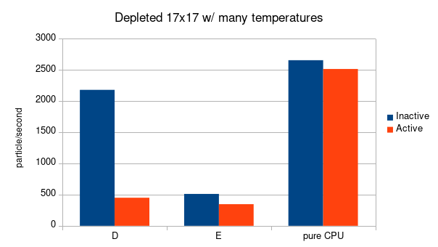
gpu openmc at mit
neutrons/second
Seems it would help to do the cross-section lookups on the GPU, right?
WRONG!!! Why?
We want HUNDREDS of thousands of particles per second.
GPU Mode 1
GPU Mode 2
6-core Xeon CPU

Slide 32
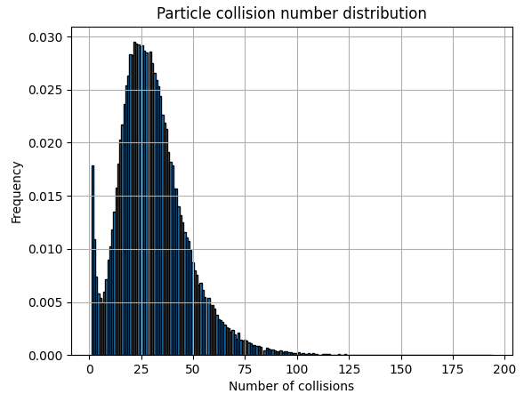



gpu openmc at mit
Seems it would help to do the cross-section lookups on the GPU, right?
WRONG!!! Why?
GPU RAM
~20 GB/s
Let’s say ~50 collisions per particle life is representative
~1 TB/s
GPU compute
cores
Above: distribution of neutron collisions before absorption.
This creates quite a bottleneck!

Slide 33
gpu openmc at mit
Assume 250 nuclides
50 collisions per neutron
40 kB microscopic cross-section cache per particle
20 GB/s bandwidth between CPU and GPU, that comes out to
no more than 10,000 particles per second!
That’s my kind of speed!
Conclusion: we should run the whole particle transport process on the GPU.
One option not yet explored would be to move all the operations requiring microscopic cross-sections to the GPU... but that gets messy.

Slide 34
gpu openmc at mit
OK, all we have to do is refactor 50,000 lines of C++ code...
Also, we can’t do it the same way we always have. Why?
Suppose we tried to have every thread (thousands of them!) run this continuous energy MC algorithm...
Some thread will be here
Here
Here
Here
Here
Here
Here
One option not yet explored would be to move all the operations requiring microscopic cross-sections to the GPU... but that gets messy.

Slide 35
gpu openmc at mit
Some thread will be here
Here
Here
That’s called “history-based” Monte Carlo, and it sucks on GPUs!
What’s the alternative?
Here
Here
Here
Here
One option not yet explored would be to move all the operations requiring microscopic cross-sections to the GPU... but that gets messy.

Slide 36
gpu openmc at mit
Why does history-based MC perform terribly? 2 reasons:
Memory
divergence
2) Warp
divergence
One option not yet explored would be to move all the operations requiring microscopic cross-sections to the GPU... but that gets messy.

Slide 37
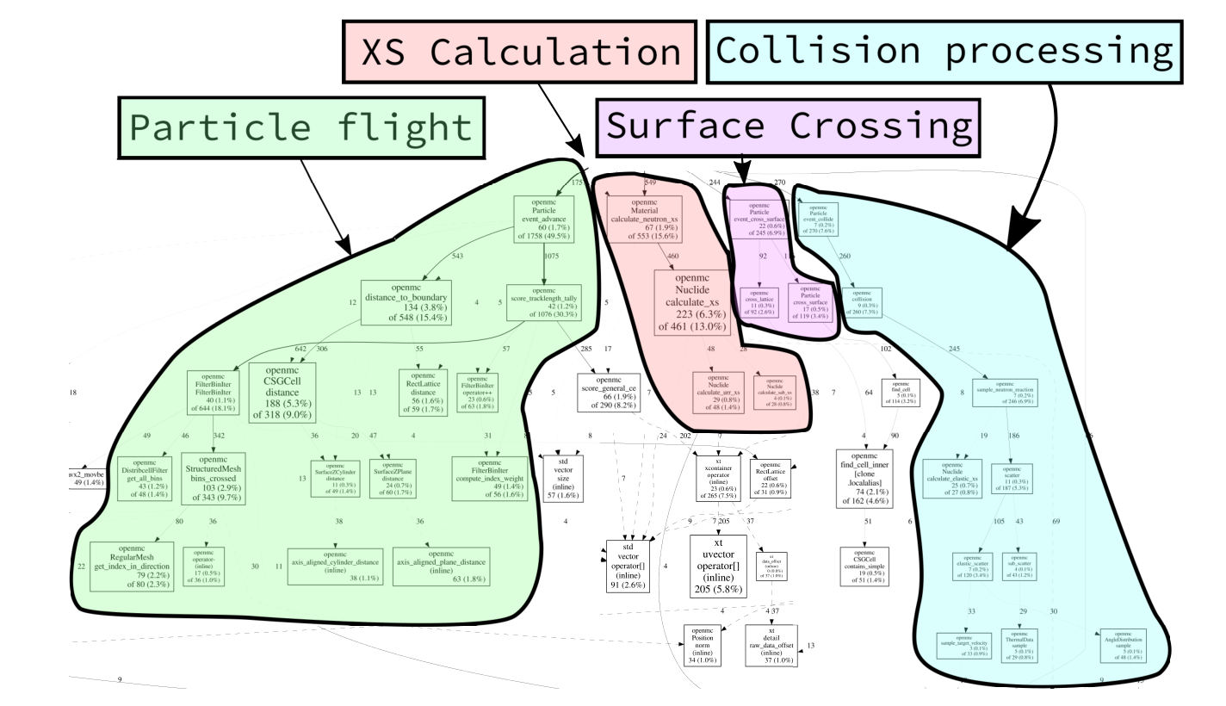
gpu openmc at mit
“Event-based” Monte Carlo was developed for vector computers
Partition the MC algorithm into a few core routines
  Collisions
  Cross-section lookups
  Surface crossings
  Particle flight
queue particles up to have the GPU execute one of the above on a large number of particles
One option not yet explored would be to move all the operations requiring microscopic cross-sections to the GPU... but that gets messy.
Notes:
The main idea here is that the amount of memory or thread divergence that can happen at this point is capped. You’ll be resynchronized every time you start the next event.

Slide 38
gpu openmc at mit
“Event-based” Monte Carlo is not a new thing:
  E. Troubetzkoy, H. Steinberg, and M. Kalos, “Monte Carlo Radiation Penetration Calculations on a Parallel Computer,” Trans. Am. Nucl. Soc, vol. 17, no. 260, 1973.
Many details have changed since then, but the fundamentals are the same!
Forrest Brown’s PhD was on event MC.
Above: A Cray-1 computer, source Wikimedia Commons/CC
One option not yet explored would be to move all the operations requiring microscopic cross-sections to the GPU... but that gets messy.
Notes:
The main idea here is that the amount of memory or thread divergence that can happen at this point is capped. You’ll be resynchronized every time you start the next event.

Slide 39
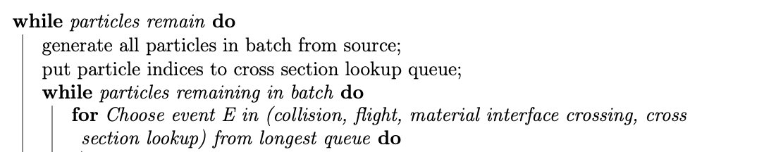
gpu openmc at mit
  Let’s look at some pseudocode for the event MC algorithm.
  First initialize all particles into a large array: a few million!
(to be continued)
One option not yet explored would be to move all the operations requiring microscopic cross-sections to the GPU... but that gets messy.
Notes:
The main idea here is that the amount of memory or thread divergence that can happen at this point is capped. You’ll be resynchronized every time you start the next event.
Point out that “reference remapping” was in Forrest Brown’s PhD.

Slide 40
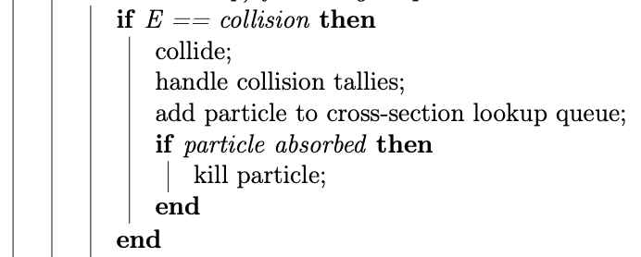

gpu openmc at mit
If we’re processing the collision queue:
One option not yet explored would be to move all the operations requiring microscopic cross-sections to the GPU... but that gets messy.
Notes:
The main idea here is that the amount of memory or thread divergence that can happen at this point is capped. You’ll be resynchronized every time you start the next event.
Point out that “reference remapping” was in Forrest Brown’s PhD.

Slide 41
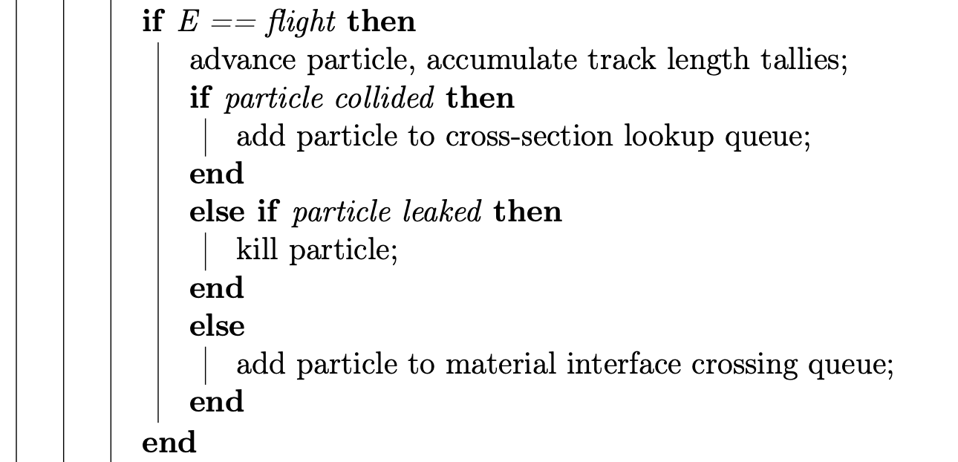

gpu openmc at mit
If we’re processing the advancement queue:
One option not yet explored would be to move all the operations requiring microscopic cross-sections to the GPU... but that gets messy.
Notes:
The main idea here is that the amount of memory or thread divergence that can happen at this point is capped. You’ll be resynchronized every time you start the next event.
Point out that “reference remapping” was in Forrest Brown’s PhD.

Slide 42
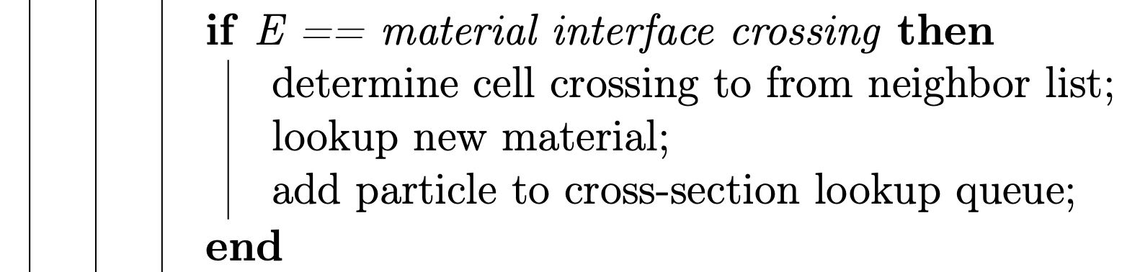

gpu openmc at mit
If we’re processing the material crossing queue:
One option not yet explored would be to move all the operations requiring microscopic cross-sections to the GPU... but that gets messy.
Notes:
The main idea here is that the amount of memory or thread divergence that can happen at this point is capped. You’ll be resynchronized every time you start the next event.
Point out that “reference remapping” was in Forrest Brown’s PhD.

Slide 43
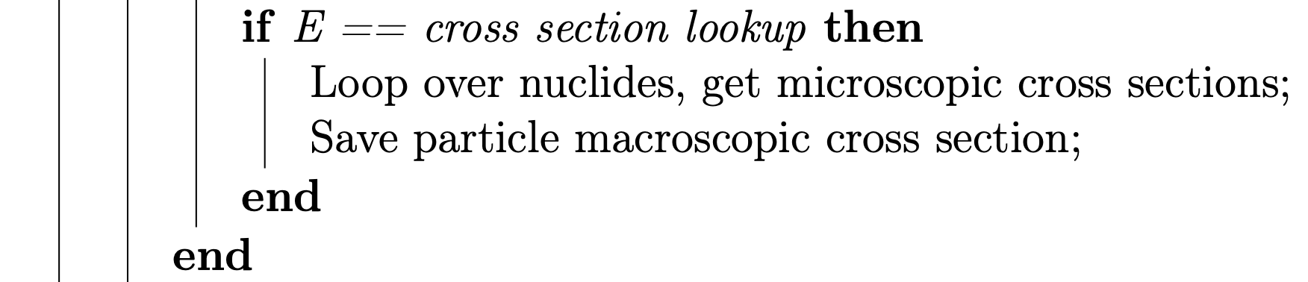

gpu openmc at mit
Lastly and most importantly!
By far the most computationally intense part.
One option not yet explored would be to move all the operations requiring microscopic cross-sections to the GPU... but that gets messy.
Notes:
The main idea here is that the amount of memory or thread divergence that can happen at this point is capped. You’ll be resynchronized every time you start the next event.
Point out that “reference remapping” was in Forrest Brown’s PhD.

Slide 44

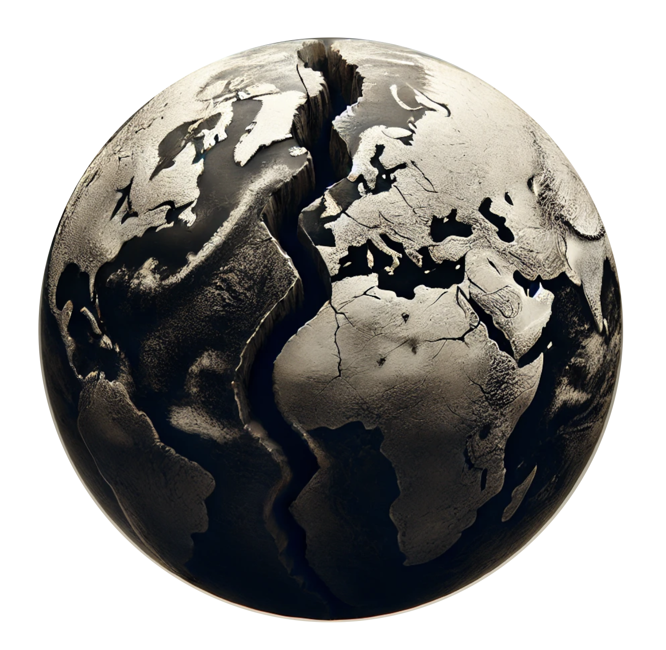



gpu openmc at mit
Now we know what the code should do. But how do we write it?
NVIDIA CUDA
Unified memory
Polymorphism
Maintain code similarity
Re-implement C++ containers, not the surrounding code
First to publish
OpenMP 5 target offloading
Manual memory management
Tagged unions
Re-implement all code to be C rather than C++ (essentially)
Second to publish but far better performance!

Slide 45
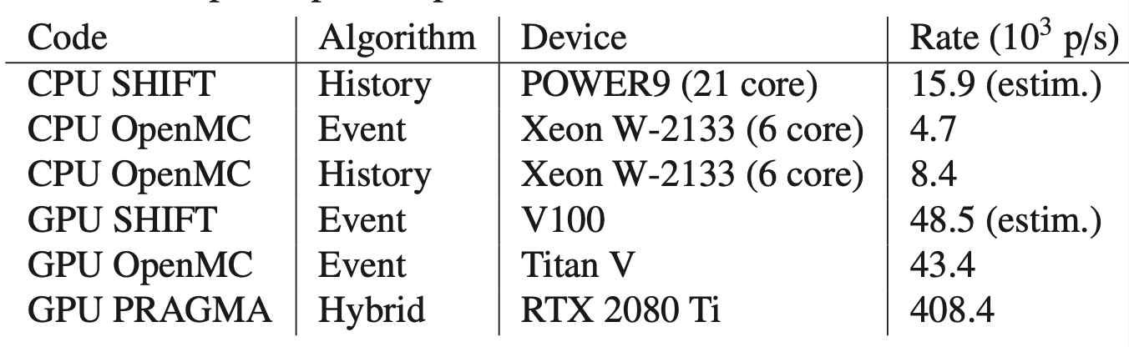
gpu openmc at mit
Results, at first, were not stellar relative to recent achievements in South Korea.
My novel contributions:
Parallel scan for queue operations
Threadsafe neighbor lists on GPU
Nice design pattern for array of structs
Implementation of open-source standard library containers that work as you’d like them to on GPU
Below: 2021 GPU OpenMC results vs. others
Ridley, Gavin, and Benoit Forget. “Design and Optimization of GPU Capabilities
in OpenMC.” ANS Winter Conference, Washington D.C., 2021.
Notes:
That is to say many other people have had the same experience.

Slide 46
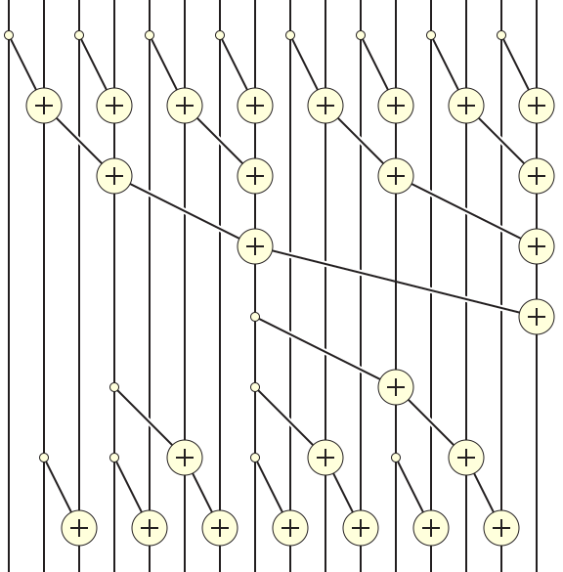
gpu openmc at mit
Parallel scan for queue operations:
Threads that need to be written to some queue set a flag value to 1, else 0.
0 0 1 1 0 1 1 0 0 0 1 0 1 0 1 1
6.6x speedup for
particle flight!
The running sum can be computed by an efficient parallel algorithm.
The result is the relative location each active thread should write to:
0 0 0 1 1 1 2 3 3 3 3 4 4 5 5 6
Ridley, Gavin, and Benoit Forget. “Design and Optimization of GPU Capabilities
in OpenMC.” ANS Winter Conference, Washington D.C., 2021.
Notes:
Comment about how dumb it is they got rid of the parallel programming class and replaced it with Julia. It’s just bindings brah
Be sure to talk about how this helps a lot in problems with a small # of nuclides.
Has since been superseded by warp intrinsic implementation of atomic add.
Not too different in nature than Paul’s proposal to use parallel scans to distribution fission sites: just apply a standard parallel algorithm to a problem nuclear engineers have previously done bad at!
Be sure to talk about how the alternative is an atomic increment.

Slide 47
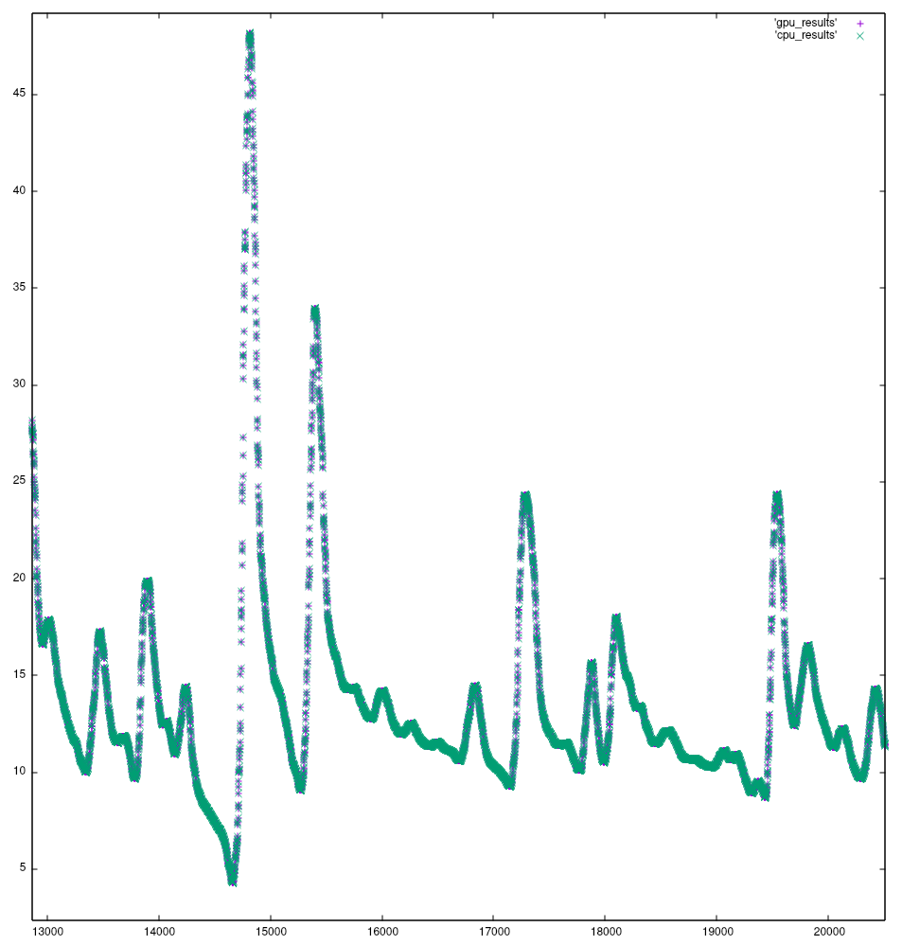
gpu openmc at mit
Why does sorting the cross-section lookup queue help?*
σ (b)
E (eV)
Unsorted,
serial bandwidth
* S. P. Hamilton and T. M. Evans, “Continuous-energy Monte Carlo neutron transport on GPUs in the Shift code,” Annals of Nuclear Energy, vol. 128, pp. 236–247, Jun. 2019
Notes:
That is to say many other people have had the same experience.

Slide 48
gpu openmc at mit
Why does sorting the cross-section lookup queue help?*
σ (b)
E (eV)
Sorted,
low particle
count
* S. P. Hamilton and T. M. Evans, “Continuous-energy Monte Carlo neutron transport on GPUs in the Shift code,” Annals of Nuclear Energy, vol. 128, pp. 236–247, Jun. 2019
Notes:
That is to say many other people have had the same experience.

Slide 49

gpu openmc at mit
Why does sorting the cross-section lookup queue help?*
σ (b)
E (eV)
Sorted,
high particle
count
fast!
* S. P. Hamilton and T. M. Evans, “Continuous-energy Monte Carlo neutron transport on GPUs in the Shift code,” Annals of Nuclear Energy, vol. 128, pp. 236–247, Jun. 2019
Notes:
That is to say many other people have had the same experience.

Slide 50

gpu openmc at mit
I realized both the folks at Argonne and myself were doing something very wrong.
We could get highly coalesced memory accesses to the cross-section lookup
But then we would go and save it in a cache that was uncoalesced, silly!
Threads sorted by energy
Each cache entry has microscopic cross-sections for each nuclide,
about 40 kB each.
But the cache was not!
Notes:
Remember the meeting in 2019 with Steven Hamilton and Tom Evans, and how they said “yeah we cache the macro.”
They mean to say ONLY the macroscopics. That’s the way to go!!

Slide 51
gpu openmc at mit
The key to high performance: don’t try to cache microscopic cross-sections.
Only get the macroscopic!
Every memory access in GPU programming should make you feel guilty.
Threads sorted by energy
Don’t use the cache! Only save macroscopic cross-sections. This can be kept in registers, not in memory.
Notes:
This was the single most impactful impact to Exascale Computing Project I made, but we can’t really publish about it because it’s more about a dumb thing you should NOT do.
It is almost too buried in the implementation details.

Slide 52
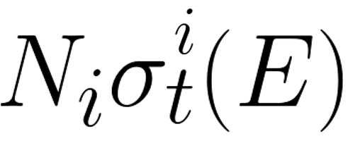
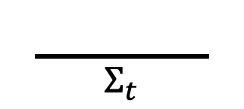
gpu openmc at mit
What’s the catch?
We need to sample the nuclide a neutron is colliding with in the collision event.
Probability of nuclide i being the collision nuclide =
That means we have to re-calculate the cross-sections at every collision!
Calculate the total cross-section for particle flight
Sample from the discrete distribution knowing the total cross-section
$$\frac{ }{Σ_{t}}$$

Slide 53
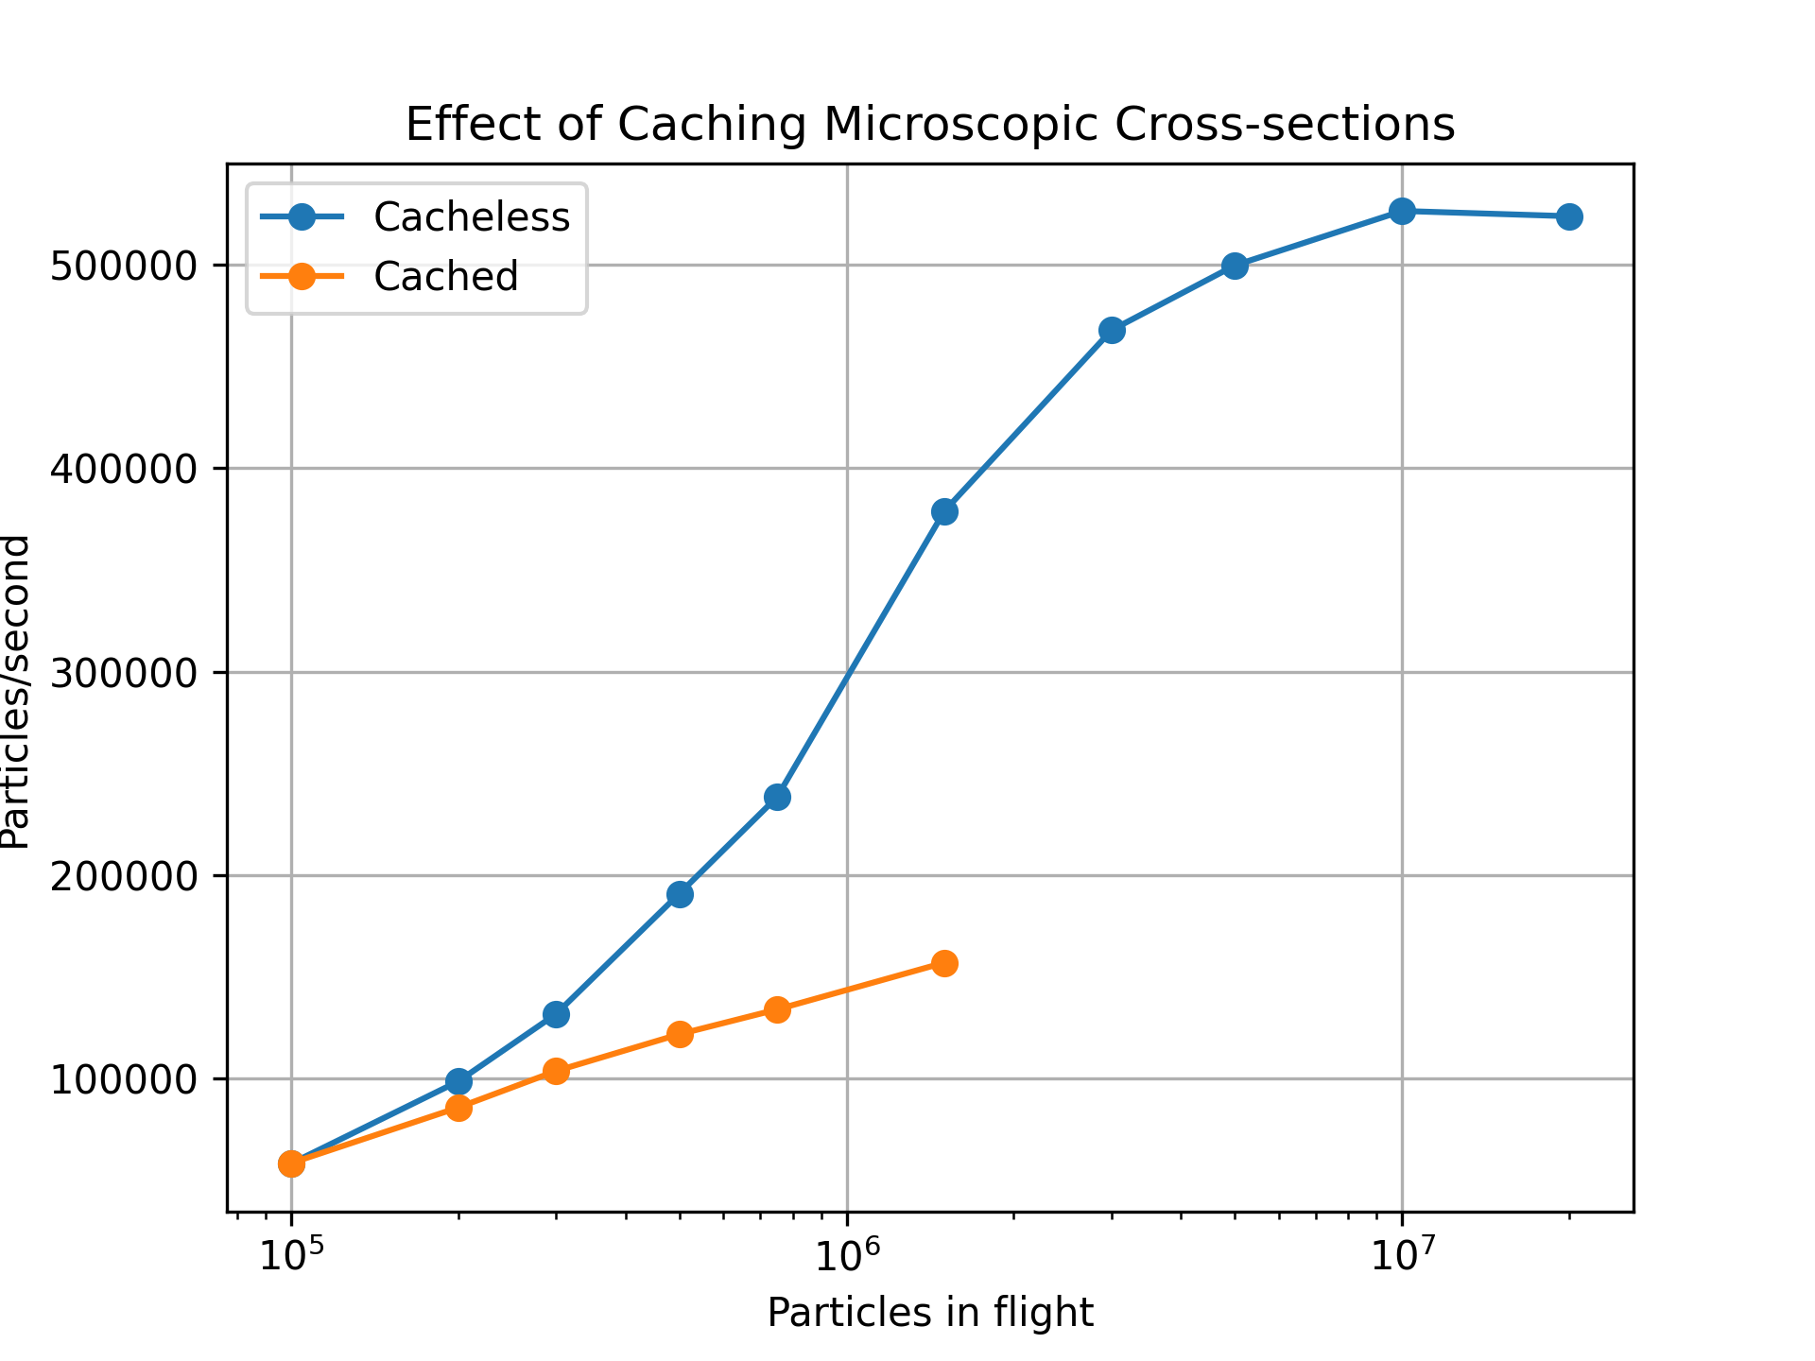
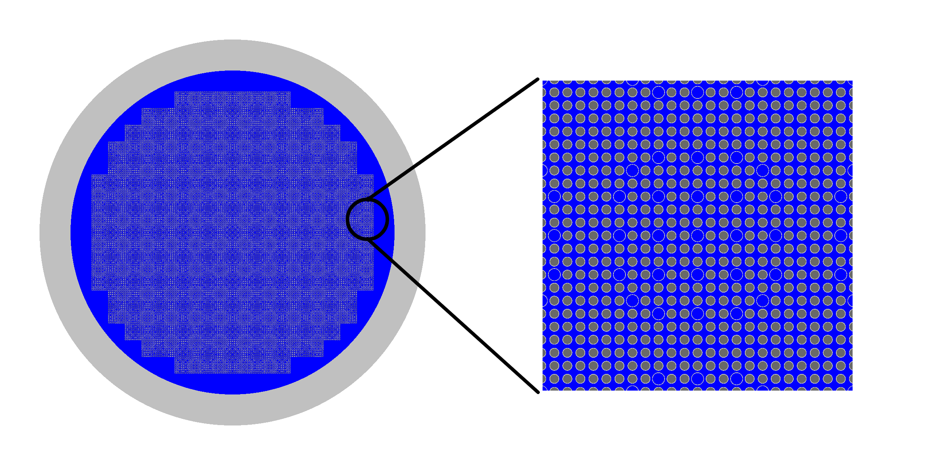
gpu openmc at mit
Finally, some results!
Hoogenboom-Martin benchmark* with simulated depleted fuel
Dramatic improvement for ANL and MIT
Above: particle processing rate for cacheless method on an NVIDIA H100
*https: //github.com/jtramm/openmc_offloading_benchmarks

Slide 54
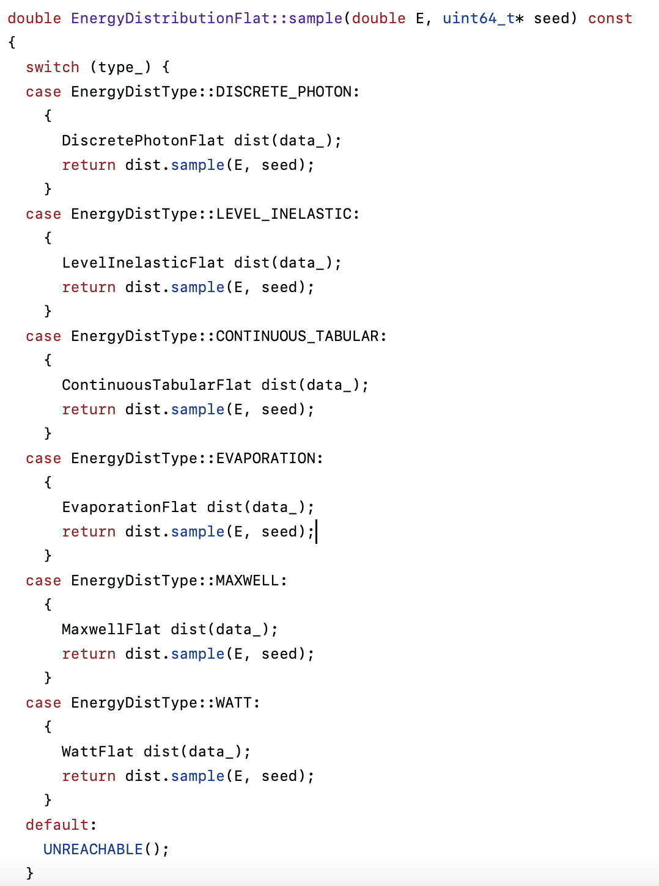
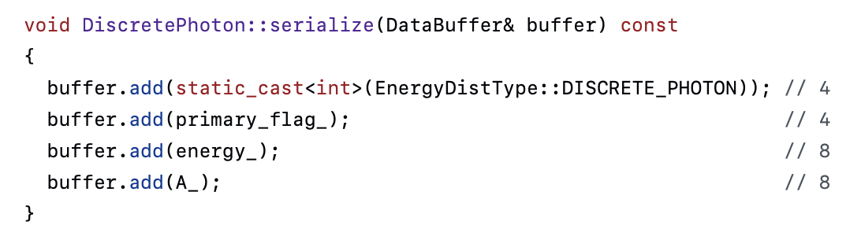
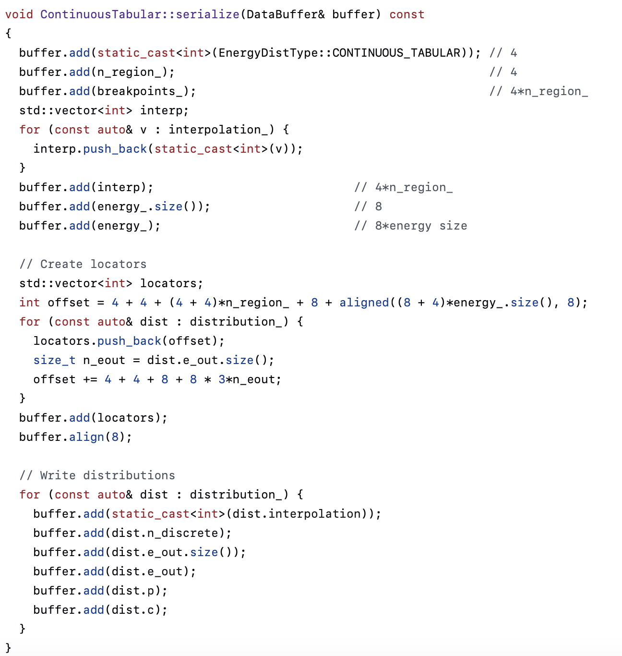
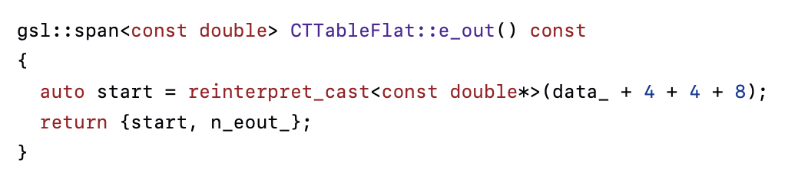
gpu openmc at mit
More: how do the ANL and MIT implementations differ?
MIT extra energy distribution code for GPU:
Argonne extra energy distribution code:
✨magical✨
values
Nada!
How?
🤢
2x as much code
Notes:
Note that variant would be far superior to use

Slide 55
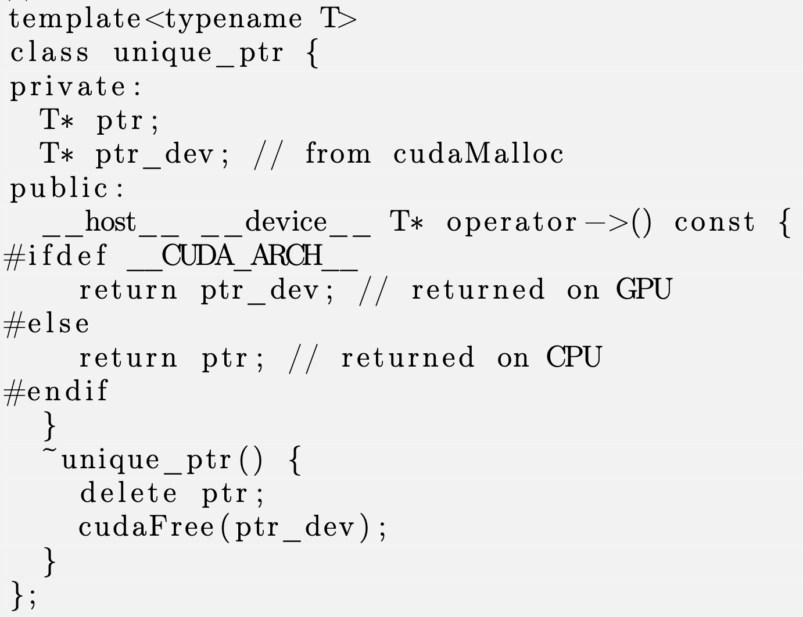
gpu openmc at mit
Implement standard containers to work reasonably on GPU
Memory allocator classes to automatically handle various allocation policies
This is what put people to sleep at ANS Winter in 2021; only Tim cares!
For details on all others (vector, tensor, static array, ...) see thesis!
Above: implementation of a GPU-ready smart pointer.
Notes:
Note that variant would be far superior to use
Crowdstrike probably should have used smart pointers lol

Slide 56
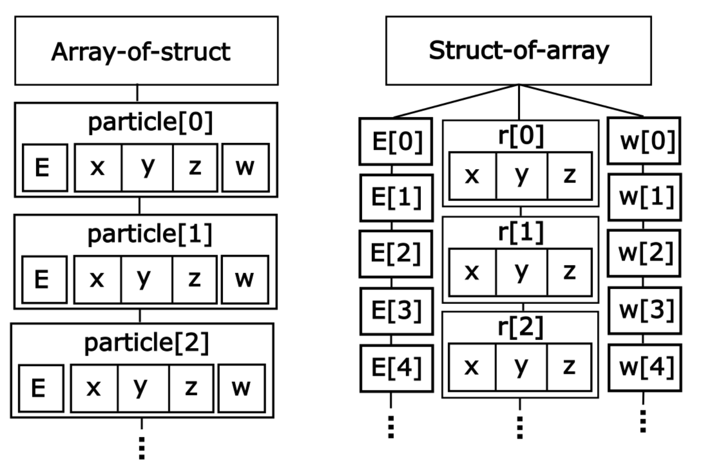
gpu openmc at mit
Novel contribution: abstraction for clean struct-of-array or array-of-struct particle data
Implement data handling in a base class
Physics in a derived class (no polymorphism)
Minimal effort to switch between the two
Above: Array-of-struct vs. struct-of-array.

Slide 57
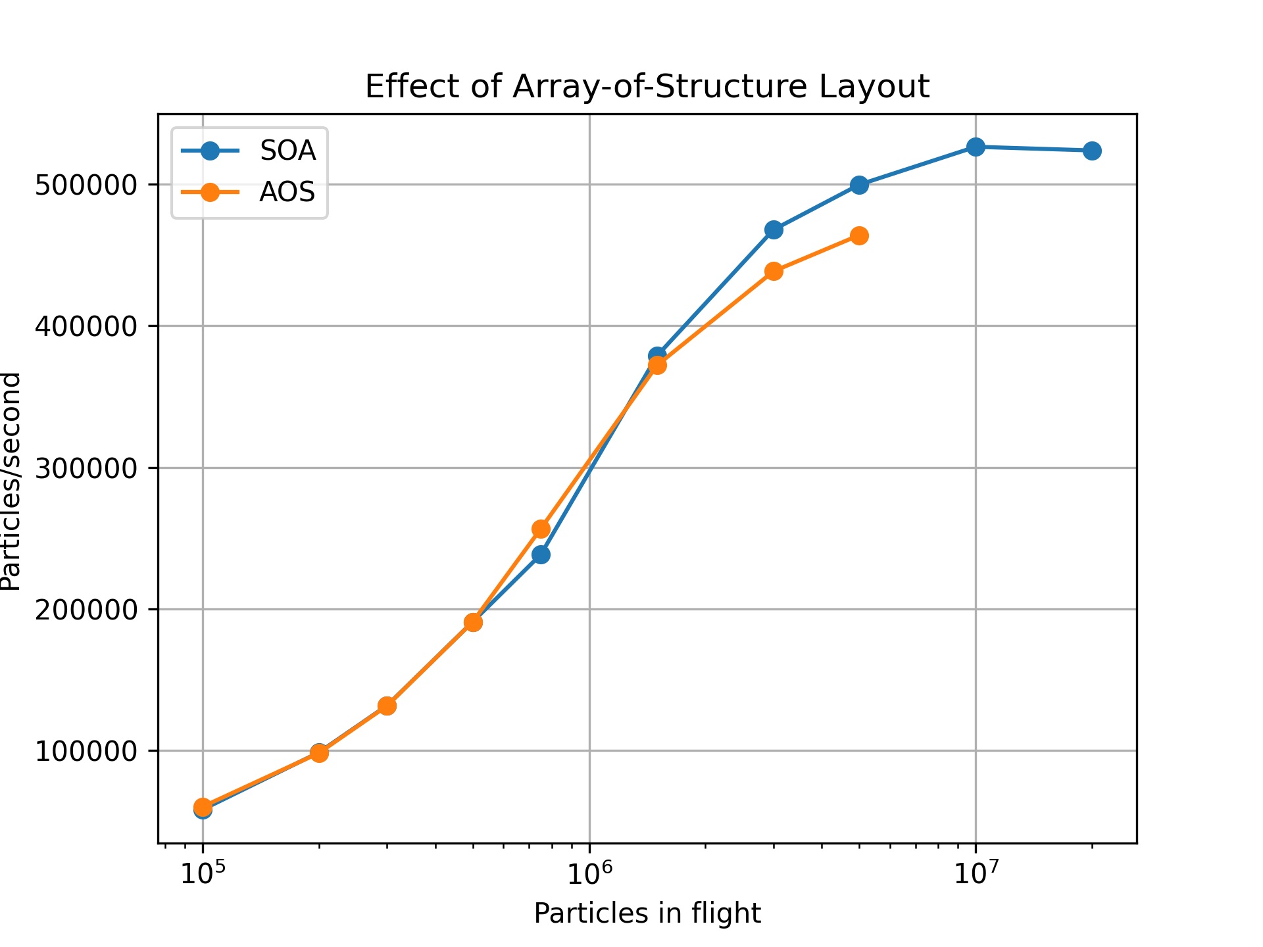
gpu openmc at mit
Proof that it’s easy to switch between the two ➡️
Nobody has presented a comparison like this to my knowledge.
Argonne is still using array-of-struct, could improve results by switching.
This is standard knowledge.
Above: struct-of-array clearly wins but only at higher particle counts!

Slide 58
windowed multipole formalism
Lookup operations on a pointwise grid are time consuming!
Pointwise cross-sections require different grids at each temperature, not good!
  Kiss your coalesced memory accesses goodbye
A solution is to use the physics-based cross-section data format developed within CRPG!
This was the original approach proposed by the researchers from Seoul National University* but was later abandoned... why?
*N. Choi, K. Kim, and H. Joo, “Initial Development of PRAGMA - A GPU-Based Continuous Energy Monte Carlo Code for Practical Applications,” Proceedings of the Korean Nuclear Society Autumn Meeting, Goyang, Korea, Oct. 24-25, 2019.

Slide 59
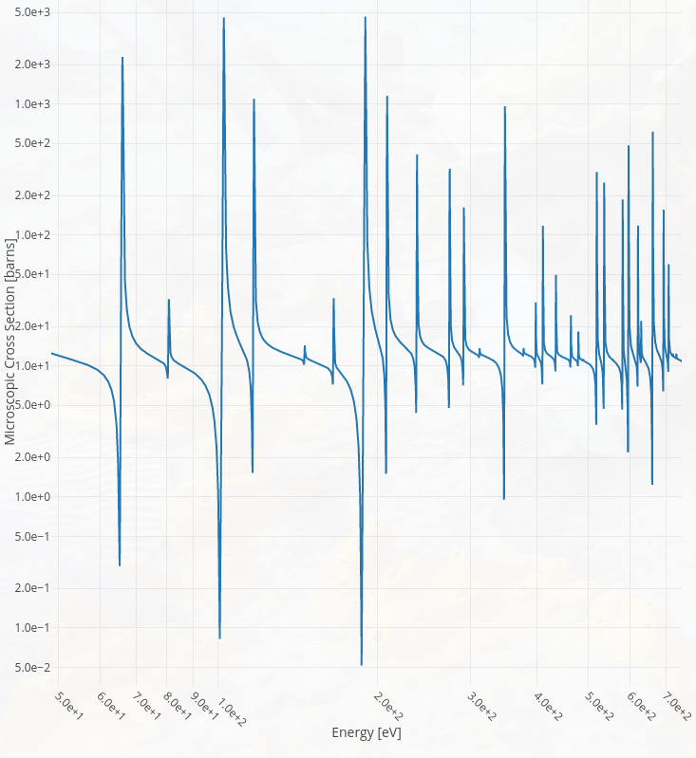
windowed multipole formalism
Windowed multipole* represents the cross section as an expansion over poles
Windowing obviates need to evaluate all resonance contributions, rather, collective behavior fit with polynomial
(made with xsplot.com)
*Josey, C., P. Ducru, B. Forget, and K. Smith. “Windowed Multipole for Cross Section Doppler Broadening.” Journal of Computational Physics 307 (February 15, 2016)

Slide 60
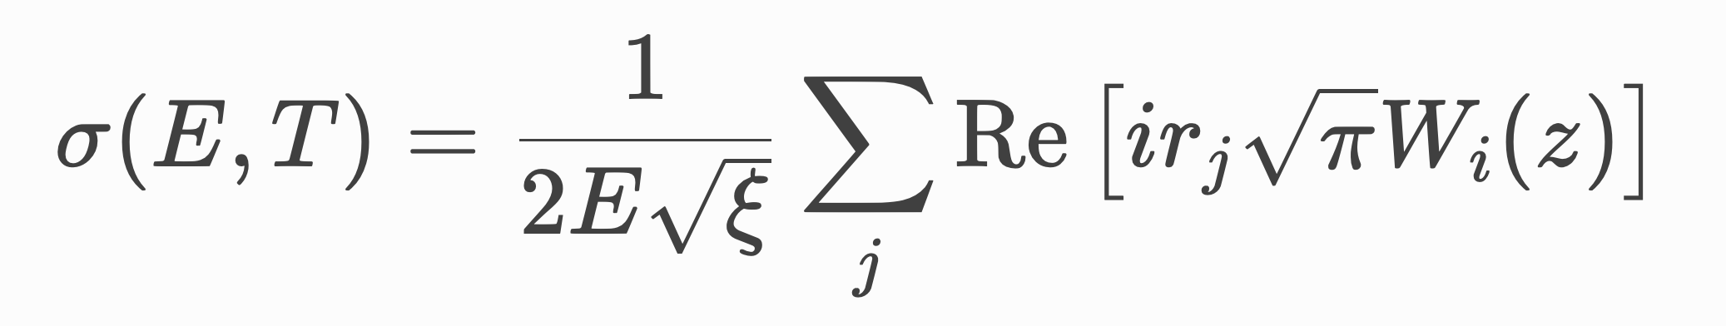
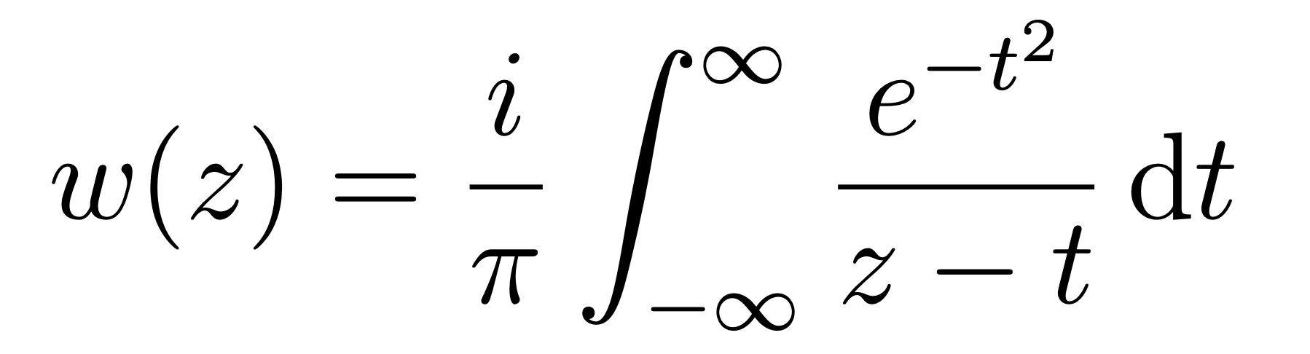
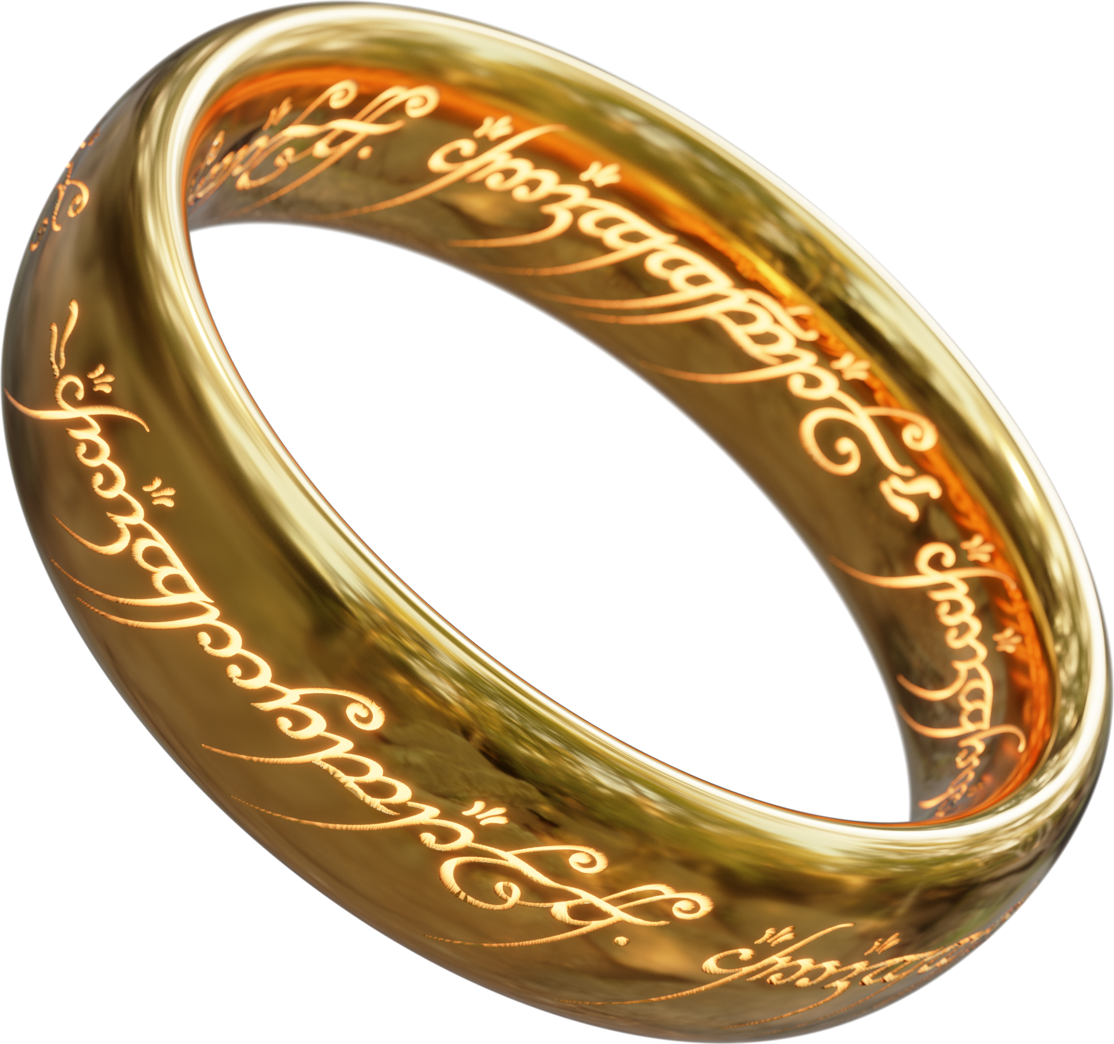
windowed multipole formalism
This is just the zero-kelvin cross-section. What about for positive temperature?
Doppler broadening can be done analytically in windowed multipole (pardon the different summation notation please)
Implication: one dataset to rule all temperatures!
Josey, C., P. Ducru, B. Forget, and K. Smith. “Windowed Multipole for Cross Section Doppler Broadening.” Journal of Computational Physics 307 (February 15, 2016)
Notes:
Note how many lame papers are out there about on-the-fly Doppler broadening e.g. using fast fourier transforms.

Slide 61
windowed multipole on gpu
One problem: how do we calculate w(z) on a GPU?
The classic “MIT implementation” * (not from us) is terrible on GPU!
Dr. Forget’s observation: far simpler approaches exist!
static double erfcx_y100(double y100)
{
switch ((int) y100) {
case 0: {
double t = 2*y100 - 1;
return 0.70878032454106438663e-3 + (0.71234091047026302958e-3 + (0.35779077297597742384e-5 + (0.17403143962587937815e-7 + (0.81710660047307788845e-10 + (0.36885022360434957634e-12 + 0.15917038551111111111e-14 * t) * t) * t) * t) * t) * t;
}
case 1: {
double t = 2*y100 - 3;
return 0.21479143208285144230e-2 + (0.72686402367379996033e-3 + (0.36843175430938995552e-5 + (0.18071841272149201685e-7 + (0.85496449296040325555e-10 + (0.38852037518534291510e-12 + 0.16868473576888888889e-14 * t) * t) * t) * t) * t) * t;
}
case 2: {
double t = 2*y100 - 5;
return 0.36165255935630175090e-2 + (0.74182092323555510862e-3 + (0.37948319957528242260e-5 + (0.18771627021793087350e-7 + (0.89484715122415089123e-10 + (0.40935858517772440862e-12 + 0.17872061464888888889e-14 * t) * t) * t) * t) * t) * t;
}
case 3: {
double t = 2*y100 - 7;
return 0.51154983860031979264e-2 + (0.75722840734791660540e-3 + (0.39096425726735703941e-5 + (0.19504168704300468210e-7 + (0.93687503063178993915e-10 + (0.43143925959079664747e-12 + 0.18939926435555555556e-14 * t) * t) * t) * t) * t) * t;
}
case 4: {
double t = 2*y100 - 9;
return 0.66457513172673049824e-2 + (0.77310406054447454920e-3 + (0.40289510589399439385e-5 + (0.20271233238288381092e-7 + (0.98117631321709100264e-10 + (0.45484207406017752971e-12 + 0.20076352213333333333e-14 * t) * t) * t) * t) * t) * t;
}
case 5: {
double t = 2*y100 - 11;
return 0.82082389970241207883e-2 + (0.78946629611881710721e-3 + (0.41529701552622656574e-5 + (0.21074693344544655714e-7 + (0.10278874108587317989e-9 + (0.47965201390613339638e-12 + 0.21285907413333333333e-14 * t) * t) * t) * t) * t) * t;
}
case 6: {
double t = 2*y100 - 13;
return 0.98039537275352193165e-2 + (0.80633440108342840956e-3 + (0.42819241329736982942e-5 + (0.21916534346907168612e-7 + (0.10771535136565470914e-9 + (0.50595972623692822410e-12 + 0.22573462684444444444e-14 * t) * t) * t) * t) * t) * t;
}
case 7: {
double t = 2*y100 - 15;
return 0.11433927298290302370e-1 + (0.82372858383196561209e-3 + (0.44160495311765438816e-5 + (0.22798861426211986056e-7 + (0.11291291745879239736e-9 + (0.53386189365816880454e-12 + 0.23944209546666666667e-14 * t) * t) * t) * t) * t) * t;
}
case 8: {
double t = 2*y100 - 17;
return 0.13099232878814653979e-1 + (0.84167002467906968214e-3 + (0.45555958988457506002e-5 + (0.23723907357214175198e-7 + (0.11839789326602695603e-9 + (0.56346163067550237877e-12 + 0.25403679644444444444e-14 * t) * t) * t) * t) * t) * t;
}
case 9: {
double t = 2*y100 - 19;
return 0.14800987015587535621e-1 + (0.86018092946345943214e-3 + (0.47008265848816866105e-5 + (0.24694040760197315333e-7 + (0.12418779768752299093e-9 + (0.59486890370320261949e-12 + 0.26957764568888888889e-14 * t) * t) * t) * t) * t) * t;
}
case 10: {
double t = 2*y100 - 21;
return 0.16540351739394069380e-1 + (0.87928458641241463952e-3 + (0.48520195793001753903e-5 + (0.25711774900881709176e-7 + (0.13030128534230822419e-9 + (0.62820097586874779402e-12 + 0.28612737351111111111e-14 * t) * t) * t) * t) * t) * t;
}
case 11: {
double t = 2*y100 - 23;
return 0.18318536789842392647e-1 + (0.89900542647891721692e-3 + (0.50094684089553365810e-5 + (0.26779777074218070482e-7 + (0.13675822186304615566e-9 + (0.66358287745352705725e-12 + 0.30375273884444444444e-14 * t) * t) * t) * t) * t) * t;
}
case 12: {
double t = 2*y100 - 25;
return 0.20136801964214276775e-1 + (0.91936908737673676012e-3 + (0.51734830914104276820e-5 + (0.27900878609710432673e-7 + (0.14357976402809042257e-9 + (0.70114790311043728387e-12 + 0.32252476000000000000e-14 * t) * t) * t) * t) * t) * t;
}
case 13: {
double t = 2*y100 - 27;
return 0.21996459598282740954e-1 + (0.94040248155366777784e-3 + (0.53443911508041164739e-5 + (0.29078085538049374673e-7 + (0.15078844500329731137e-9 + (0.74103813647499204269e-12 + 0.34251892320000000000e-14 * t) * t) * t) * t) * t) * t;
}
case 14: {
double t = 2*y100 - 29;
return 0.23898877187226319502e-1 + (0.96213386835900177540e-3 + (0.55225386998049012752e-5 + (0.30314589961047687059e-7 + (0.15840826497296335264e-9 + (0.78340500472414454395e-12 + 0.36381553564444444445e-14 * t) * t) * t) * t) * t) * t;
}
case 15: {
double t = 2*y100 - 31;
return 0.25845480155298518485e-1 + (0.98459293067820123389e-3 + (0.57082915920051843672e-5 + (0.31613782169164830118e-7 + (0.16646478745529630813e-9 + (0.82840985928785407942e-12 + 0.38649975768888888890e-14 * t) * t) * t) * t) * t) * t;
}
case 16: {
double t = 2*y100 - 33;
return 0.27837754783474696598e-1 + (0.10078108563256892757e-2 + (0.59020366493792212221e-5 + (0.32979263553246520417e-7 + (0.17498524159268458073e-9 + (0.87622459124842525110e-12 + 0.41066206488888888890e-14 * t) * t) * t) * t) * t) * t;
}
case 17: {
double t = 2*y100 - 35;
return 0.29877251304899307550e-1 + (0.10318204245057349310e-2 + (0.61041829697162055093e-5 + (0.34414860359542720579e-7 + (0.18399863072934089607e-9 + (0.92703227366365046533e-12 + 0.43639844053333333334e-14 * t) * t) * t) * t) * t) * t;
}
case 18: {
double t = 2*y100 - 37;
return 0.31965587178596443475e-1 + (0.10566560976716574401e-2 + (0.63151633192414586770e-5 + (0.35924638339521924242e-7 + (0.19353584758781174038e-9 + (0.98102783859889264382e-12 + 0.46381060817777777779e-14 * t) * t) * t) * t) * t) * t;
}
case 19: {
double t = 2*y100 - 39;
return 0.34104450552588334840e-1 + (0.10823541191350532574e-2 + (0.65354356159553934436e-5 + (0.37512918348533521149e-7 + (0.20362979635817883229e-9 + (0.10384187833037282363e-11 + 0.49300625262222222221e-14 * t) * t) * t) * t) * t) * t;
}
case 20: {
double t = 2*y100 - 41;
return 0.36295603928292425716e-1 + (0.11089526167995268200e-2 + (0.67654845095518363577e-5 + (0.39184292949913591646e-7 + (0.21431552202133775150e-9 + (0.10994259106646731797e-11 + 0.52409949102222222221e-14 * t) * t) * t) * t) * t) * t;
}
case 21: {
double t = 2*y100 - 43;
return 0.38540888038840509795e-1 + (0.11364917134175420009e-2 + (0.70058230641246312003e-5 + (0.40943644083718586939e-7 + (0.22563034723692881631e-9 + (0.11642841011361992885e-11 + 0.55721092871111111110e-14 * t) * t) * t) * t) * t) * t;
}
case 22: {
double t = 2*y100 - 45;
return 0.40842225954785960651e-1 + (0.11650136437945673891e-2 + (0.72569945502343006619e-5 + (0.42796161861855042273e-7 + (0.23761401711005024162e-9 + (0.12332431172381557035e-11 + 0.59246802364444444445e-14 * t) * t) * t) * t) * t) * t;
}
case 23: {
double t = 2*y100 - 47;
return 0.43201627431540222422e-1 + (0.11945628793917272199e-2 + (0.75195743532849206263e-5 + (0.44747364553960993492e-7 + (0.25030885216472953674e-9 + (0.13065684400300476484e-11 + 0.63000532853333333334e-14 * t) * t) * t) * t) * t) * t;
}
case 24: {
double t = 2*y100 - 49;
return 0.45621193513810471438e-1 + (0.12251862608067529503e-2 + (0.77941720055551920319e-5 + (0.46803119830954460212e-7 + (0.26375990983978426273e-9 + (0.13845421370977119765e-11 + 0.66996477404444444445e-14 * t) * t) * t) * t) * t) * t;
}
case 25: {
double t = 2*y100 - 51;
return 0.48103121413299865517e-1 + (0.12569331386432195113e-2 + (0.80814333496367673980e-5 + (0.48969667335682018324e-7 + (0.27801515481905748484e-9 + (0.14674637611609884208e-11 + 0.71249589351111111110e-14 * t) * t) * t) * t) * t) * t;
}
case 26: {
double t = 2*y100 - 53;
return 0.50649709676983338501e-1 + (0.12898555233099055810e-2 + (0.83820428414568799654e-5 + (0.51253642652551838659e-7 + (0.29312563849675507232e-9 + (0.15556512782814827846e-11 + 0.75775607822222222221e-14 * t) * t) * t) * t) * t) * t;
}
case 27: {
double t = 2*y100 - 55;
return 0.53263363664388864181e-1 + (0.13240082443256975769e-2 + (0.86967260015007658418e-5 + (0.53662102750396795566e-7 + (0.30914568786634796807e-9 + (0.16494420240828493176e-11 + 0.80591079644444444445e-14 * t) * t) * t) * t) * t) * t;
}
case 28: {
double t = 2*y100 - 57;
return 0.55946601353500013794e-1 + (0.13594491197408190706e-2 + (0.90262520233016380987e-5 + (0.56202552975056695376e-7 + (0.32613310410503135996e-9 + (0.17491936862246367398e-11 + 0.85713381688888888890e-14 * t) * t) * t) * t) * t) * t;
}
case 29: {
double t = 2*y100 - 59;
return 0.58702059496154081813e-1 + (0.13962391363223647892e-2 + (0.93714365487312784270e-5 + (0.58882975670265286526e-7 + (0.34414937110591753387e-9 + (0.18552853109751857859e-11 + 0.91160736711111111110e-14 * t) * t) * t) * t) * t) * t;
}
case 30: {
double t = 2*y100 - 61;
return 0.61532500145144778048e-1 + (0.14344426411912015247e-2 + (0.97331446201016809696e-5 + (0.61711860507347175097e-7 + (0.36325987418295300221e-9 + (0.19681183310134518232e-11 + 0.96952238400000000000e-14 * t) * t) * t) * t) * t) * t;
}
case 31: {
double t = 2*y100 - 63;
return 0.64440817576653297993e-1 + (0.14741275456383131151e-2 + (0.10112293819576437838e-4 + (0.64698236605933246196e-7 + (0.38353412915303665586e-9 + (0.20881176114385120186e-11 + 0.10310784480000000000e-13 * t) * t) * t) * t) * t) * t;
}
case 32: {
double t = 2*y100 - 65;
return 0.67430045633130393282e-1 + (0.15153655418916540370e-2 + (0.10509857606888328667e-4 + (0.67851706529363332855e-7 + (0.40504602194811140006e-9 + (0.22157325110542534469e-11 + 0.10964842115555555556e-13 * t) * t) * t) * t) * t) * t;
}
case 33: {
double t = 2*y100 - 67;
return 0.70503365513338850709e-1 + (0.15582323336495709827e-2 + (0.10926868866865231089e-4 + (0.71182482239613507542e-7 + (0.42787405890153386710e-9 + (0.23514379522274416437e-11 + 0.11659571751111111111e-13 * t) * t) * t) * t) * t) * t;
}
case 34: {
double t = 2*y100 - 69;
return 0.73664114037944596353e-1 + (0.16028078812438820413e-2 + (0.11364423678778207991e-4 + (0.74701423097423182009e-7 + (0.45210162777476488324e-9 + (0.24957355004088569134e-11 + 0.12397238257777777778e-13 * t) * t) * t) * t) * t) * t;
}
case 35: {
double t = 2*y100 - 71;
return 0.76915792420819562379e-1 + (0.16491766623447889354e-2 + (0.11823685320041302169e-4 + (0.78420075993781544386e-7 + (0.47781726956916478925e-9 + (0.26491544403815724749e-11 + 0.13180196462222222222e-13 * t) * t) * t) * t) * t) * t;
}
case 36: {
double t = 2*y100 - 73;
return 0.80262075578094612819e-1 + (0.16974279491709504117e-2 + (0.12305888517309891674e-4 + (0.82350717698979042290e-7 + (0.50511496109857113929e-9 + (0.28122528497626897696e-11 + 0.14010889635555555556e-13 * t) * t) * t) * t) * t) * t;
}
case 37: {
double t = 2*y100 - 75;
return 0.83706822008980357446e-1 + (0.17476561032212656962e-2 + (0.12812343958540763368e-4 + (0.86506399515036435592e-7 + (0.53409440823869467453e-9 + (0.29856186620887555043e-11 + 0.14891851591111111111e-13 * t) * t) * t) * t) * t) * t;
}
case 38: {
double t = 2*y100 - 77;
return 0.87254084284461718231e-1 + (0.17999608886001962327e-2 + (0.13344443080089492218e-4 + (0.90900994316429008631e-7 + (0.56486134972616465316e-9 + (0.31698707080033956934e-11 + 0.15825697795555555556e-13 * t) * t) * t) * t) * t) * t;
}
case 39: {
double t = 2*y100 - 79;
return 0.90908120182172748487e-1 + (0.18544478050657699758e-2 + (0.13903663143426120077e-4 + (0.95549246062549906177e-7 + (0.59752787125242054315e-9 + (0.33656597366099099413e-11 + 0.16815130613333333333e-13 * t) * t) * t) * t) * t) * t;
}
case 40: {
double t = 2*y100 - 81;
return 0.94673404508075481121e-1 + (0.19112284419887303347e-2 + (0.14491572616545004930e-4 + (0.10046682186333613697e-6 + (0.63221272959791000515e-9 + (0.35736693975589130818e-11 + 0.17862931591111111111e-13 * t) * t) * t) * t) * t) * t;
}
case 41: {
double t = 2*y100 - 83;
return 0.98554641648004456555e-1 + (0.19704208544725622126e-2 + (0.15109836875625443935e-4 + (0.10567036667675984067e-6 + (0.66904168640019354565e-9 + (0.37946171850824333014e-11 + 0.18971959040000000000e-13 * t) * t) * t) * t) * t) * t;
}
case 42: {
double t = 2*y100 - 85;
return 0.10255677889470089531e0 + (0.20321499629472857418e-2 + (0.15760224242962179564e-4 + (0.11117756071353507391e-6 + (0.70814785110097658502e-9 + (0.40292553276632563925e-11 + 0.20145143075555555556e-13 * t) * t) * t) * t) * t) * t;
}
case 43: {
double t = 2*y100 - 87;
return 0.10668502059865093318e0 + (0.20965479776148731610e-2 + (0.16444612377624983565e-4 + (0.11700717962026152749e-6 + (0.74967203250938418991e-9 + (0.42783716186085922176e-11 + 0.21385479360000000000e-13 * t) * t) * t) * t) * t) * t;
}
case 44: {
double t = 2*y100 - 89;
return 0.11094484319386444474e0 + (0.21637548491908170841e-2 + (0.17164995035719657111e-4 + (0.12317915750735938089e-6 + (0.79376309831499633734e-9 + (0.45427901763106353914e-11 + 0.22696025653333333333e-13 * t) * t) * t) * t) * t) * t;
}
case 45: {
double t = 2*y100 - 91;
return 0.11534201115268804714e0 + (0.22339187474546420375e-2 + (0.17923489217504226813e-4 + (0.12971465288245997681e-6 + (0.84057834180389073587e-9 + (0.48233721206418027227e-11 + 0.24079890062222222222e-13 * t) * t) * t) * t) * t) * t;
}
case 46: {
double t = 2*y100 - 93;
return 0.11988259392684094740e0 + (0.23071965691918689601e-2 + (0.18722342718958935446e-4 + (0.13663611754337957520e-6 + (0.89028385488493287005e-9 + (0.51210161569225846701e-11 + 0.25540227111111111111e-13 * t) * t) * t) * t) * t) * t;
}
case 47: {
double t = 2*y100 - 95;
return 0.12457298393509812907e0 + (0.23837544771809575380e-2 + (0.19563942105711612475e-4 + (0.14396736847739470782e-6 + (0.94305490646459247016e-9 + (0.54366590583134218096e-11 + 0.27080225920000000000e-13 * t) * t) * t) * t) * t) * t;
}
case 48: {
double t = 2*y100 - 97;
return 0.12941991566142438816e0 + (0.24637684719508859484e-2 + (0.20450821127475879816e-4 + (0.15173366280523906622e-6 + (0.99907632506389027739e-9 + (0.57712760311351625221e-11 + 0.28703099555555555556e-13 * t) * t) * t) * t) * t) * t;
}
case 49: {
double t = 2*y100 - 99;
return 0.13443048593088696613e0 + (0.25474249981080823877e-2 + (0.21385669591362915223e-4 + (0.15996177579900443030e-6 + (0.10585428844575134013e-8 + (0.61258809536787882989e-11 + 0.30412080142222222222e-13 * t) * t) * t) * t) * t) * t;
}
case 50: {
double t = 2*y100 - 101;
return 0.13961217543434561353e0 + (0.26349215871051761416e-2 + (0.22371342712572567744e-4 + (0.16868008199296822247e-6 + (0.11216596910444996246e-8 + (0.65015264753090890662e-11 + 0.32210394506666666666e-13 * t) * t) * t) * t) * t) * t;
}
case 51: {
double t = 2*y100 - 103;
return 0.14497287157673800690e0 + (0.27264675383982439814e-2 + (0.23410870961050950197e-4 + (0.17791863939526376477e-6 + (0.11886425714330958106e-8 + (0.68993039665054288034e-11 + 0.34101266222222222221e-13 * t) * t) * t) * t) * t) * t;
}
case 52: {
double t = 2*y100 - 105;
return 0.15052089272774618151e0 + (0.28222846410136238008e-2 + (0.24507470422713397006e-4 + (0.18770927679626136909e-6 + (0.12597184587583370712e-8 + (0.73203433049229821618e-11 + 0.36087889048888888890e-13 * t) * t) * t) * t) * t) * t;
}
case 53: {
double t = 2*y100 - 107;
return 0.15626501395774612325e0 + (0.29226079376196624949e-2 + (0.25664553693768450545e-4 + (0.19808568415654461964e-6 + (0.13351257759815557897e-8 + (0.77658124891046760667e-11 + 0.38173420035555555555e-13 * t) * t) * t) * t) * t) * t;
}
case 54: {
double t = 2*y100 - 109;
return 0.16221449434620737567e0 + (0.30276865332726475672e-2 + (0.26885741326534564336e-4 + (0.20908350604346384143e-6 + (0.14151148144240728728e-8 + (0.82369170665974313027e-11 + 0.40360957457777777779e-13 * t) * t) * t) * t) * t) * t;
}
case 55: {
double t = 2*y100 - 111;
return 0.16837910595412130659e0 + (0.31377844510793082301e-2 + (0.28174873844911175026e-4 + (0.22074043807045782387e-6 + (0.14999481055996090039e-8 + (0.87348993661930809254e-11 + 0.42653528977777777779e-13 * t) * t) * t) * t) * t) * t;
}
case 56: {
double t = 2*y100 - 113;
return 0.17476916455659369953e0 + (0.32531815370903068316e-2 + (0.29536024347344364074e-4 + (0.23309632627767074202e-6 + (0.15899007843582444846e-8 + (0.92610375235427359475e-11 + 0.45054073102222222221e-13 * t) * t) * t) * t) * t) * t;
}
case 57: {
double t = 2*y100 - 115;
return 0.18139556223643701364e0 + (0.33741744168096996041e-2 + (0.30973511714709500836e-4 + (0.24619326937592290996e-6 + (0.16852609412267750744e-8 + (0.98166442942854895573e-11 + 0.47565418097777777779e-13 * t) * t) * t) * t) * t) * t;
}
case 58: {
double t = 2*y100 - 117;
return 0.18826980194443664549e0 + (0.35010775057740317997e-2 + (0.32491914440014267480e-4 + (0.26007572375886319028e-6 + (0.17863299617388376116e-8 + (0.10403065638343878679e-10 + 0.50190265831111111110e-13 * t) * t) * t) * t) * t) * t;
}
case 59: {
double t = 2*y100 - 119;
return 0.19540403413693967350e0 + (0.36342240767211326315e-2 + (0.34096085096200907289e-4 + (0.27479061117017637474e-6 + (0.18934228504790032826e-8 + (0.11021679075323598664e-10 + 0.52931171733333333334e-13 * t) * t) * t) * t) * t) * t;
}
case 60: {
double t = 2*y100 - 121;
return 0.20281109560651886959e0 + (0.37739673859323597060e-2 + (0.35791165457592409054e-4 + (0.29038742889416172404e-6 + (0.20068685374849001770e-8 + (0.11673891799578381999e-10 + 0.55790523093333333334e-13 * t) * t) * t) * t) * t) * t;
}
case 61: {
double t = 2*y100 - 123;
return 0.21050455062669334978e0 + (0.39206818613925652425e-2 + (0.37582602289680101704e-4 + (0.30691836231886877385e-6 + (0.21270101645763677824e-8 + (0.12361138551062899455e-10 + 0.58770520160000000000e-13 * t) * t) * t) * t) * t) * t;
}
case 62: {
double t = 2*y100 - 125;
return 0.21849873453703332479e0 + (0.40747643554689586041e-2 + (0.39476163820986711501e-4 + (0.32443839970139918836e-6 + (0.22542053491518680200e-8 + (0.13084879235290858490e-10 + 0.61873153262222222221e-13 * t) * t) * t) * t) * t) * t;
}
case 63: {
double t = 2*y100 - 127;
return 0.22680879990043229327e0 + (0.42366354648628516935e-2 + (0.41477956909656896779e-4 + (0.34300544894502810002e-6 + (0.23888264229264067658e-8 + (0.13846596292818514601e-10 + 0.65100183751111111110e-13 * t) * t) * t) * t) * t) * t;
}
case 64: {
double t = 2*y100 - 129;
return 0.23545076536988703937e0 + (0.44067409206365170888e-2 + (0.43594444916224700881e-4 + (0.36268045617760415178e-6 + (0.25312606430853202748e-8 + (0.14647791812837903061e-10 + 0.68453122631111111110e-13 * t) * t) * t) * t) * t) * t;
}
case 65: {
double t = 2*y100 - 131;
return 0.24444156740777432838e0 + (0.45855530511605787178e-2 + (0.45832466292683085475e-4 + (0.38352752590033030472e-6 + (0.26819103733055603460e-8 + (0.15489984390884756993e-10 + 0.71933206364444444445e-13 * t) * t) * t) * t) * t) * t;
}
case 66: {
double t = 2*y100 - 133;
return 0.25379911500634264643e0 + (0.47735723208650032167e-2 + (0.48199253896534185372e-4 + (0.40561404245564732314e-6 + (0.28411932320871165585e-8 + (0.16374705736458320149e-10 + 0.75541379822222222221e-13 * t) * t) * t) * t) * t) * t;
}
case 67: {
double t = 2*y100 - 135;
return 0.26354234756393613032e0 + (0.49713289477083781266e-2 + (0.50702455036930367504e-4 + (0.42901079254268185722e-6 + (0.30095422058900481753e-8 + (0.17303497025347342498e-10 + 0.79278273368888888890e-13 * t) * t) * t) * t) * t) * t;
}
case 68: {
double t = 2*y100 - 137;
return 0.27369129607732343398e0 + (0.51793846023052643767e-2 + (0.53350152258326602629e-4 + (0.45379208848865015485e-6 + (0.31874057245814381257e-8 + (0.18277905010245111046e-10 + 0.83144182364444444445e-13 * t) * t) * t) * t) * t) * t;
}
case 69: {
double t = 2*y100 - 139;
return 0.28426714781640316172e0 + (0.53983341916695141966e-2 + (0.56150884865255810638e-4 + (0.48003589196494734238e-6 + (0.33752476967570796349e-8 + (0.19299477888083469086e-10 + 0.87139049137777777779e-13 * t) * t) * t) * t) * t) * t;
}
case 70: {
double t = 2*y100 - 141;
return 0.29529231465348519920e0 + (0.56288077305420795663e-2 + (0.59113671189913307427e-4 + (0.50782393781744840482e-6 + (0.35735475025851713168e-8 + (0.20369760937017070382e-10 + 0.91262442613333333334e-13 * t) * t) * t) * t) * t) * t;
}
case 71: {
double t = 2*y100 - 143;
return 0.30679050522528838613e0 + (0.58714723032745403331e-2 + (0.62248031602197686791e-4 + (0.53724185766200945789e-6 + (0.37827999418960232678e-8 + (0.21490291930444538307e-10 + 0.95513539182222222221e-13 * t) * t) * t) * t) * t) * t;
}
case 72: {
double t = 2*y100 - 145;
return 0.31878680111173319425e0 + (0.61270341192339103514e-2 + (0.65564012259707640976e-4 + (0.56837930287837738996e-6 + (0.40035151353392378882e-8 + (0.22662596341239294792e-10 + 0.99891109760000000000e-13 * t) * t) * t) * t) * t) * t;
}
case 73: {
double t = 2*y100 - 147;
return 0.33130773722152622027e0 + (0.63962406646798080903e-2 + (0.69072209592942396666e-4 + (0.60133006661885941812e-6 + (0.42362183765883466691e-8 + (0.23888182347073698382e-10 + 0.10439349811555555556e-12 * t) * t) * t) * t) * t) * t;
}
case 74: {
double t = 2*y100 - 149;
return 0.34438138658041336523e0 + (0.66798829540414007258e-2 + (0.72783795518603561144e-4 + (0.63619220443228800680e-6 + (0.44814499336514453364e-8 + (0.25168535651285475274e-10 + 0.10901861383111111111e-12 * t) * t) * t) * t) * t) * t;
}
case 75: {
double t = 2*y100 - 151;
return 0.35803744972380175583e0 + (0.69787978834882685031e-2 + (0.76710543371454822497e-4 + (0.67306815308917386747e-6 + (0.47397647975845228205e-8 + (0.26505114141143050509e-10 + 0.11376390933333333333e-12 * t) * t) * t) * t) * t) * t;
}
case 76: {
double t = 2*y100 - 153;
return 0.37230734890119724188e0 + (0.72938706896461381003e-2 + (0.80864854542670714092e-4 + (0.71206484718062688779e-6 + (0.50117323769745883805e-8 + (0.27899342394100074165e-10 + 0.11862637614222222222e-12 * t) * t) * t) * t) * t) * t;
}
case 77: {
double t = 2*y100 - 155;
return 0.38722432730555448223e0 + (0.76260375162549802745e-2 + (0.85259785810004603848e-4 + (0.75329383305171327677e-6 + (0.52979361368388119355e-8 + (0.29352606054164086709e-10 + 0.12360253370666666667e-12 * t) * t) * t) * t) * t) * t;
}
case 78: {
double t = 2*y100 - 157;
return 0.40282355354616940667e0 + (0.79762880915029728079e-2 + (0.89909077342438246452e-4 + (0.79687137961956194579e-6 + (0.55989731807360403195e-8 + (0.30866246101464869050e-10 + 0.12868841946666666667e-12 * t) * t) * t) * t) * t) * t;
}
case 79: {
double t = 2*y100 - 159;
return 0.41914223158913787649e0 + (0.83456685186950463538e-2 + (0.94827181359250161335e-4 + (0.84291858561783141014e-6 + (0.59154537751083485684e-8 + (0.32441553034347469291e-10 + 0.13387957943111111111e-12 * t) * t) * t) * t) * t) * t;
}
case 80: {
double t = 2*y100 - 161;
return 0.43621971639463786896e0 + (0.87352841828289495773e-2 + (0.10002929142066799966e-3 + (0.89156148280219880024e-6 + (0.62480008150788597147e-8 + (0.34079760983458878910e-10 + 0.13917107176888888889e-12 * t) * t) * t) * t) * t) * t;
}
case 81: {
double t = 2*y100 - 163;
return 0.45409763548534330981e0 + (0.91463027755548240654e-2 + (0.10553137232446167258e-3 + (0.94293113464638623798e-6 + (0.65972492312219959885e-8 + (0.35782041795476563662e-10 + 0.14455745872000000000e-12 * t) * t) * t) * t) * t) * t;
}
case 82: {
double t = 2*y100 - 165;
return 0.47282001668512331468e0 + (0.95799574408860463394e-2 + (0.11135019058000067469e-3 + (0.99716373005509038080e-6 + (0.69638453369956970347e-8 + (0.37549499088161345850e-10 + 0.15003280712888888889e-12 * t) * t) * t) * t) * t) * t;
}
case 83: {
double t = 2*y100 - 167;
return 0.49243342227179841649e0 + (0.10037550043909497071e-1 + (0.11750334542845234952e-3 + (0.10544006716188967172e-5 + (0.73484461168242224872e-8 + (0.39383162326435752965e-10 + 0.15559069118222222222e-12 * t) * t) * t) * t) * t) * t;
}
case 84: {
double t = 2*y100 - 169;
return 0.51298708979209258326e0 + (0.10520454564612427224e-1 + (0.12400930037494996655e-3 + (0.11147886579371265246e-5 + (0.77517184550568711454e-8 + (0.41283980931872622611e-10 + 0.16122419680000000000e-12 * t) * t) * t) * t) * t) * t;
}
case 85: {
double t = 2*y100 - 171;
return 0.53453307979101369843e0 + (0.11030120618800726938e-1 + (0.13088741519572269581e-3 + (0.11784797595374515432e-5 + (0.81743383063044825400e-8 + (0.43252818449517081051e-10 + 0.16692592640000000000e-12 * t) * t) * t) * t) * t) * t;
}
case 86: {
double t = 2*y100 - 173;
return 0.55712643071169299478e0 + (0.11568077107929735233e-1 + (0.13815797838036651289e-3 + (0.12456314879260904558e-5 + (0.86169898078969313597e-8 + (0.45290446811539652525e-10 + 0.17268801084444444444e-12 * t) * t) * t) * t) * t) * t;
}
case 87: {
double t = 2*y100 - 175;
return 0.58082532122519320968e0 + (0.12135935999503877077e-1 + (0.14584223996665838559e-3 + (0.13164068573095710742e-5 + (0.90803643355106020163e-8 + (0.47397540713124619155e-10 + 0.17850211608888888889e-12 * t) * t) * t) * t) * t) * t;
}
case 88: {
double t = 2*y100 - 177;
return 0.60569124025293375554e0 + (0.12735396239525550361e-1 + (0.15396244472258863344e-3 + (0.13909744385382818253e-5 + (0.95651595032306228245e-8 + (0.49574672127669041550e-10 + 0.18435945564444444444e-12 * t) * t) * t) * t) * t) * t;
}
case 89: {
double t = 2*y100 - 179;
return 0.63178916494715716894e0 + (0.13368247798287030927e-1 + (0.16254186562762076141e-3 + (0.14695084048334056083e-5 + (0.10072078109604152350e-7 + (0.51822304995680707483e-10 + 0.19025081422222222222e-12 * t) * t) * t) * t) * t) * t;
}
case 90: {
double t = 2*y100 - 181;
return 0.65918774689725319200e0 + (0.14036375850601992063e-1 + (0.17160483760259706354e-3 + (0.15521885688723188371e-5 + (0.10601827031535280590e-7 + (0.54140790105837520499e-10 + 0.19616655146666666667e-12 * t) * t) * t) * t) * t) * t;
}
case 91: {
double t = 2*y100 - 183;
return 0.68795950683174433822e0 + (0.14741765091365869084e-1 + (0.18117679143520433835e-3 + (0.16392004108230585213e-5 + (0.11155116068018043001e-7 + (0.56530360194925690374e-10 + 0.20209663662222222222e-12 * t) * t) * t) * t) * t) * t;
}
case 92: {
double t = 2*y100 - 185;
return 0.71818103808729967036e0 + (0.15486504187117112279e-1 + (0.19128428784550923217e-3 + (0.17307350969359975848e-5 + (0.11732656736113607751e-7 + (0.58991125287563833603e-10 + 0.20803065333333333333e-12 * t) * t) * t) * t) * t) * t;
}
case 93: {
double t = 2*y100 - 187;
return 0.74993321911726254661e0 + (0.16272790364044783382e-1 + (0.20195505163377912645e-3 + (0.18269894883203346953e-5 + (0.12335161021630225535e-7 + (0.61523068312169087227e-10 + 0.21395783431111111111e-12 * t) * t) * t) * t) * t) * t;
}
case 94: {
double t = 2*y100 - 189;
return 0.78330143531283492729e0 + (0.17102934132652429240e-1 + (0.21321800585063327041e-3 + (0.19281661395543913713e-5 + (0.12963340087354341574e-7 + (0.64126040998066348872e-10 + 0.21986708942222222222e-12 * t) * t) * t) * t) * t) * t;
}
case 95: {
double t = 2*y100 - 191;
return 0.81837581041023811832e0 + (0.17979364149044223802e-1 + (0.22510330592753129006e-3 + (0.20344732868018175389e-5 + (0.13617902941839949718e-7 + (0.66799760083972474642e-10 + 0.22574701262222222222e-12 * t) * t) * t) * t) * t) * t;
}
case 96: {
double t = 2*y100 - 193;
return 0.85525144775685126237e0 + (0.18904632212547561026e-1 + (0.23764237370371255638e-3 + (0.21461248251306387979e-5 + (0.14299555071870523786e-7 + (0.69543803864694171934e-10 + 0.23158593688888888889e-12 * t) * t) * t) * t) * t) * t;
}
case 97: {
double t = 2*y100 - 195;
return 0.89402868170849933734e0 + (0.19881418399127202569e-1 + (0.25086793128395995798e-3 + (0.22633402747585233180e-5 + (0.15008997042116532283e-7 + (0.72357609075043941261e-10 + 0.23737194737777777778e-12 * t) * t) * t) * t) * t) * t;
}
case 98: {
double t = 2*y100 - 197;
return 0.93481333942870796363e0 + (0.20912536329780368893e-1 + (0.26481403465998477969e-3 + (0.23863447359754921676e-5 + (0.15746923065472184451e-7 + (0.75240468141720143653e-10 + 0.24309291271111111111e-12 * t) * t) * t) * t) * t) * t;
}
case 99: {
double t = 2*y100 - 199;
return 0.97771701335885035464e0 + (0.22000938572830479551e-1 + (0.27951610702682383001e-3 + (0.25153688325245314530e-5 + (0.16514019547822821453e-7 + (0.78191526829368231251e-10 + 0.24873652355555555556e-12 * t) * t) * t) * t) * t) * t;
}
}
Yes, this is actually the code from that library. These are all branches.
*http://ab-initio.mit.edu/faddeeva/
Notes:
Note how many lame papers are out there about on-the-fly Doppler broadening e.g. using fast fourier transforms.

Slide 62
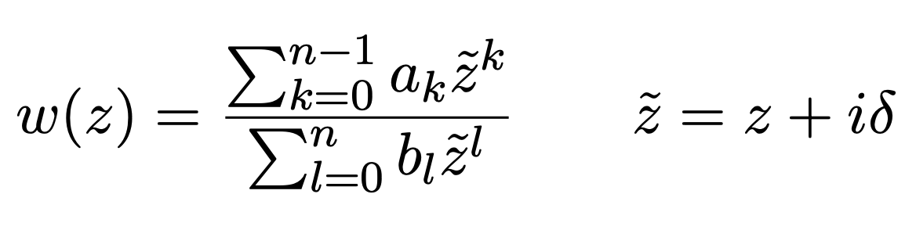
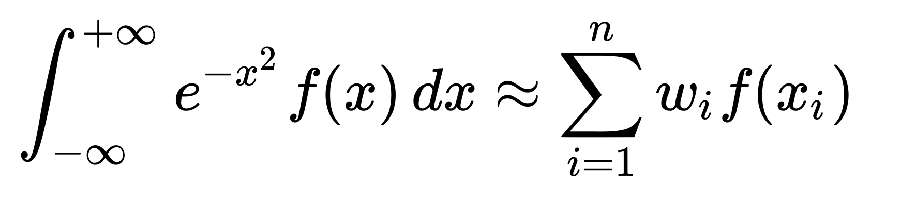
windowed multipole on gpu
Far better approach for GPUs. We approximate
Just a Gauss-Hermite quadrature:
Which reduces the Faddeeva function to be a weighted sum over poles in the (lower) complex plane!
The result:
≅
* B. Forget, J. Yu, and G. Ridley, “Performance Improvements of the Windowed Multipole Formalism using a Rational Fraction Approximation of the Faddeeva Function,” in International Conference on Physics of Reactors 2022, Pittsburg, PA, May 2022.
Notes:
Note how many lame papers are out there about on-the-fly Doppler broadening e.g. using fast fourier transforms.

Slide 63
windowed multipole on gpu
How well does it work?
Great!
My contributions:
Implementation of the CPU code
Implementation of the GPU code
Observing WMP may outperform pointwise XS with many temperature CPU problems
Showed WMP outperforms when temperature interpolation takes place
Above: WMP beats the conventional approach for general temperatures!
* B. Forget, J. Yu, and G. Ridley, “Performance Improvements of the Windowed Multipole Formalism using a Rational Fraction Approximation of the Faddeeva Function,” in International Conference on Physics of Reactors 2022, Pittsburg, PA, May 2022.
Notes:
Note how many lame papers are out there about on-the-fly Doppler broadening e.g. using fast fourier transforms.

Slide 64
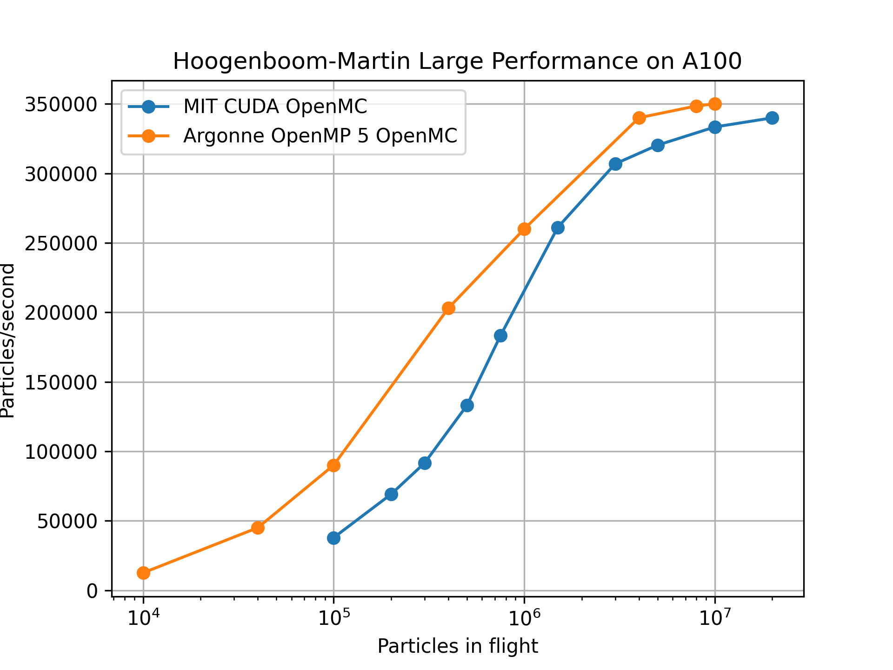
gpu openmc at mit
One last result to show:
How did the code compare to Argonne’s performance results?
Equivalent, but requiring more particles
CUDA 12 helped a ton!
Notes:
Note how many lame papers are out there about on-the-fly Doppler broadening e.g. using fast fourier transforms.

Slide 65
part 2 conclusions
Suggest use of windowed multipole for development of future GPU MC apps
Suggest extension / improvement studies on WMP
  Barycentric rational polynomial representation with semi-analytic broadening
  We have too many poles! RKFIT gives less poles, better/equal fit. AAA rules...
  Extend polynomial fits & windowing through the full energy range
  Stop using equal-lethargy energy windowing. Just do a search!
  Why even look for a globally consistent set of poles? Already have duplicates.
Suggest development of unified collision physics formalism.
1980-ifying your code will lead to limited performance benefits vs. a reasonably implemented modern approach.
Notes:
Note how many lame papers are out there about on-the-fly Doppler broadening e.g. using fast fourier transforms.

Slide 66
part three
a new resonance upscatter method

Slide 67
part 3 overview
Resonance upscatter effect
GPU performance requirements
The new method: MARS
Results showing correctness and efficiency

Slide 68
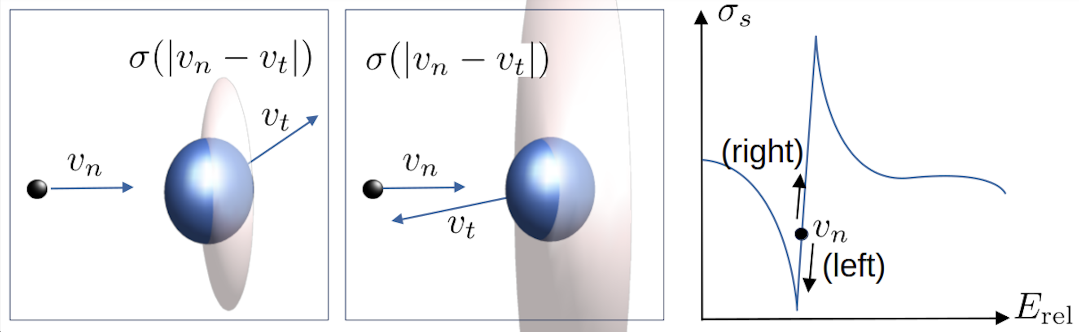
resonance upscatter
Methods for handling effect on total cross sections well-established by now, but what about the double-differential cross section?
Long ago, we approximated the cross section as constant in calculating the energy/angle distribution for scattered neutrons
This is incorrect*. 1000 pcm errors, 10%+ Doppler coeff. error in PWR
* W. Rothenstein and R. Dagan, “Two-Body Kinetics Treatment for Neutron Scattering from a Heavy Maxwellian Gas,” Annals of Nuclear Energy, 22, 11, 723 (1995)

Slide 69
resonance upscatter
Resonant scattering cross section substantially biases distribution of collision neutrons away from Maxwell-Boltzmann-like behavior
Finding the expectation value over the collision target relative speed distribution gives the Doppler broadened total cross section

Slide 70
resonance upscatter
Quintessential resonance upscatter sampling algorithm:
Doppler broadening rejection correction*
The goal is to sample from this distribution:
  Sample of target nucleus from a standard free gas algorithm
  Calculate
  Accept sample with probability, else retry
* B. Becker, R. Dagan, and G. Lohnert, “Proof and Implementation of the Stochastic Formula for Ideal Gas, Energy Dependent Scattering Kernel,” Annals of Nuclear Energy, 36, 4, 470 (2009)

Slide 71
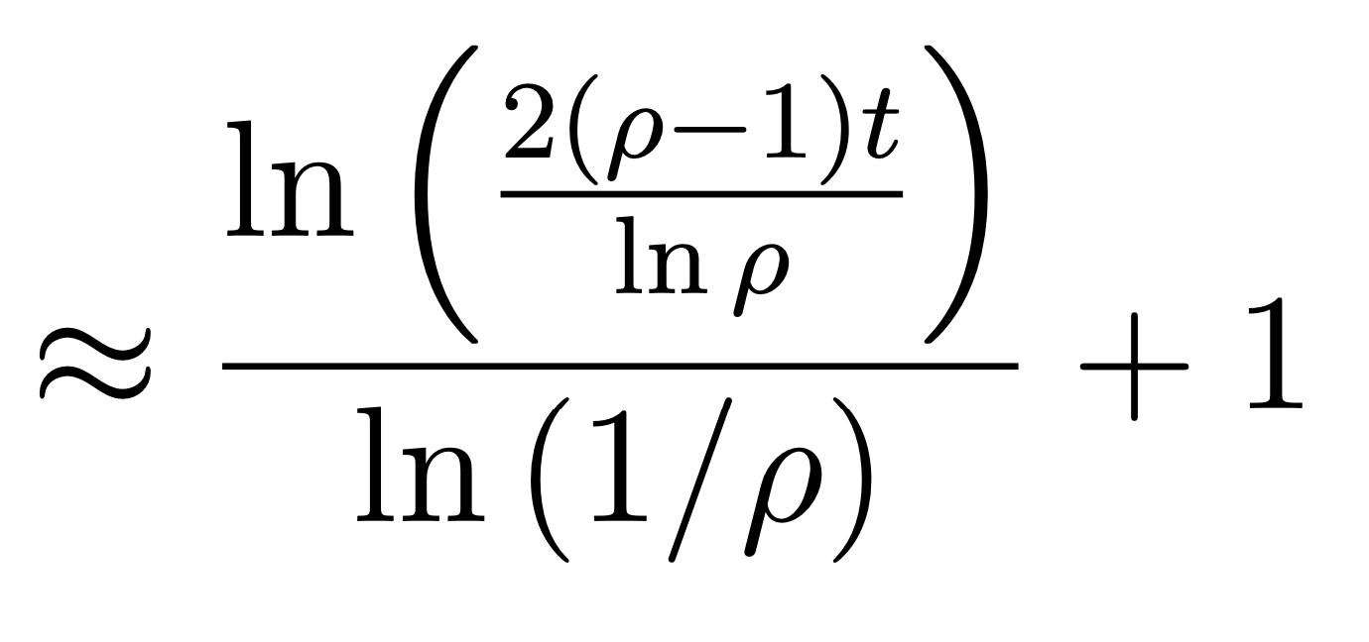
resonance upscatter
What’s the issue with DBRC on GPUs?
Works pretty alright on CPUs, but barely functions on GPU!
Comes as a result of the term
Why? Our paper* explains why, the highlight of it is:
Average number of iterations:
*Ridley, Gavin, and Benoit Forget. “A Simple Method for Rejection Sampling Efficiency Improvement on SIMT Architectures.” Statistics and Computing 31, no. 3.

Slide 72
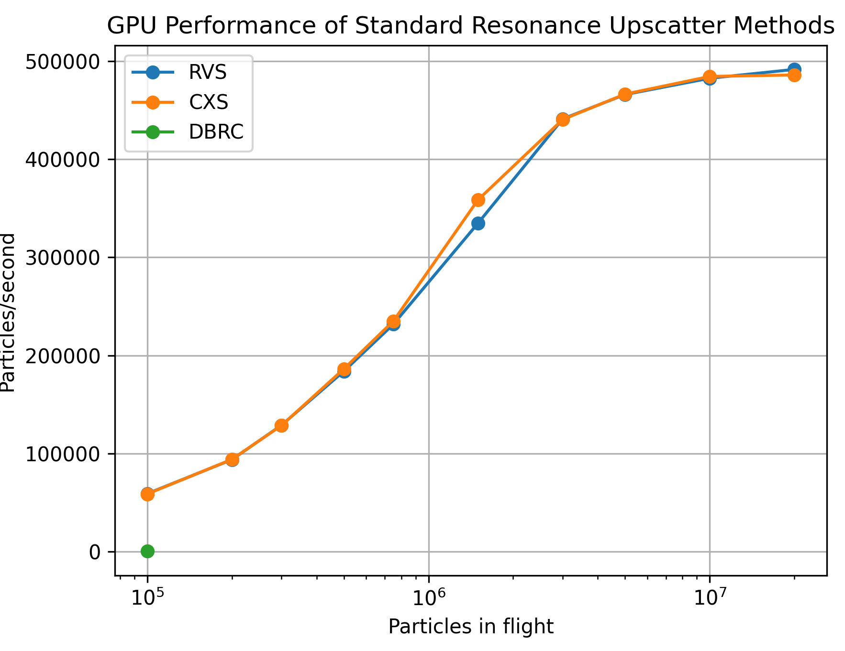
resonance upscatter gpu performance
What’s our baseline?
CXS = wrong, constant XS
DBRC = Doppler broadening rejection correction; fail!
RVS = relative velocity sampling*. Good performance, but requires extra data
* P. Romano and J. Walsh, “An improved target velocity sampling algorithm for free gas elastic scattering,” Annals of Nuclear Energy, vol. 114, pp. 318–324, Apr. 2018.

Slide 73
towards a new method
Technique from Choi and Joo* made for GPU relative speed factorization:
Choi and Joo obtained excellent results by tabulating at all points on the energy grid for nuclides of interest
Huge memory consumption 180 MB for ²³⁸U w/ 210 eV cutoff
Contains all cross section information
Build 200-point table at EVERY grid point and temperature!
Cutoff at 210 eV
* Choi, Namjae, and Han Gyu Joo. “Relative Speed Tabulation Method for Efficient Treatment of Resonance Scattering in GPU-Based Monte Carlo Neutron Transport Calculation.” Nuclear Science and Engineering 195, no. 9 (September 2, 2021)

Slide 74
towards a new method
The relative speed distribution is:
Biondo et al.* approximated the multipole expansion with a sum of Gaussians
  Seems difficult to expand to a whole nuclide library
  Never demonstrated on a full problem
My approach:
  View multipole expansion as mixture of single pole expansions
  Single pole relative speed distribution analytically tractable
negligible
Relative speed of neutron to target
Neutron speed
Zero kelvin elastic cross section
* Biondo, Elliott, Vladimir Sobes, Andrew Holcomb, Steven Hamilton, and Thomas Evans. “Algorithm for Free Gas Elastic Scattering without Rejection Sampling.” Raleigh, NC, 2021.

Slide 75
towards a new method
My approach:
  View multipole expansion as mixture of single pole expansions
  Single pole relative speed distribution analytically tractable
  Sample pole j with probability proportional to:
Faddeeva function

Slide 76
a new method
My approach:
  View multipole expansion as mixture of single pole expansions
  Single pole relative speed distribution analytically tractable
Note that probability of each pole is proportional to Doppler-broadened cross section, enabling cheap pole index sampling
We then obtain this semi-nondimensional expression for the relative speed distribution:
Ridley, Gavin, Benoit Forget, and Timothy Burke. “Resonance Scattering Treat- ment with the Windowed Multipole Formalism.” Nuclear Science and Engineering 193, no. 3 (May 25, 2023)

Slide 77
a new method
We invert the cumulative distribution function:
Where we have defined the “incomplete Faddeeva function” as:
The relationship to the standard Faddeeva function is clear:

Slide 78
a new method
No known numerical subroutines available for this function.
  I made them!
My methods are based on the identity I found:
For far-away resonances, this asymptotic formula holds:

Slide 79
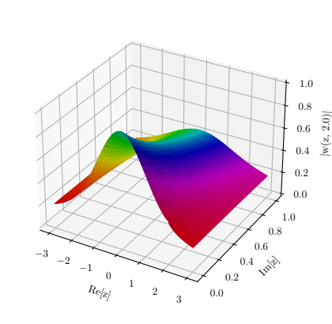
the incomplete faddeeva function
Incomplete Faddeeva function universally encodes the physics of resonance upscatter in windowed multipole formalism
Ducru et al. showed WMP is physically motivated, so this is fundamental.
Tabulation of w(z, x) enables a Choi and Joo like method, but with greatly reduced memory use and continuous temperature
We use a purely numerical technique to calculate w(z, x) on the fly
Fig:
* Ducru, Pablo, Abdulla Alhajri, Isaac Meyer, Benoit Forget, Vladimir Sobes, Colin Josey, and Jingang Liang. “Windowed Multipole Representation of R-Matrix Cross Sections.” Physical Review C 103, no. 6 (June 14, 2021): 064610. https://doi.org/10.1103/PhysRevC.103.064610.

Slide 80
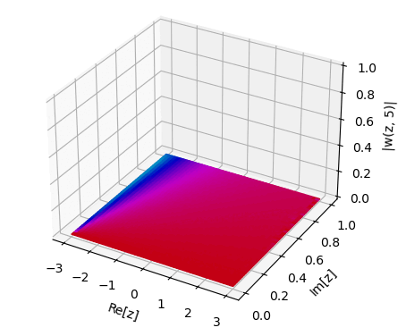
the incomplete faddeeva function
What does it look like?
Right is a plot in the upper complex plane
Height is |w(z,x)|
Color is phase
x increases from -5 to 5 in the animation
w(z, -2.6)

Slide 81
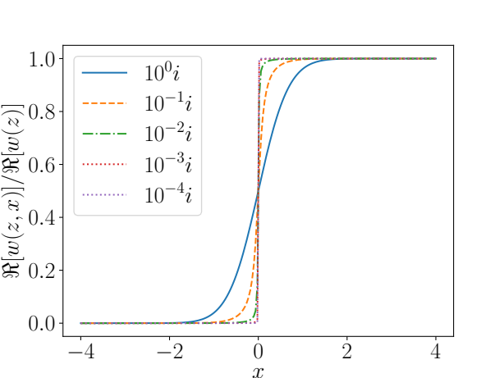
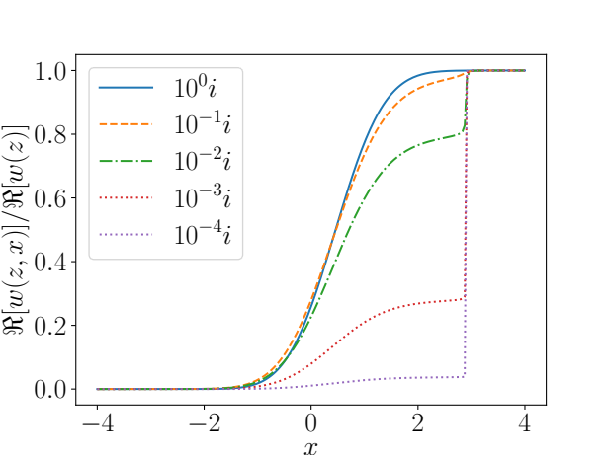
the incomplete faddeeva function
How does Re[w(z, x)] approach its asymptotic value?
  Very similar to behavior of relative speed distributions!
Re[z] = 0
Re[z] = 2.9

Slide 82
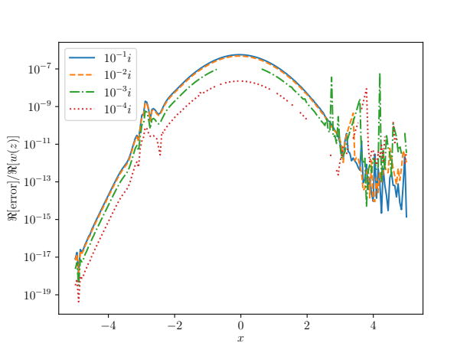
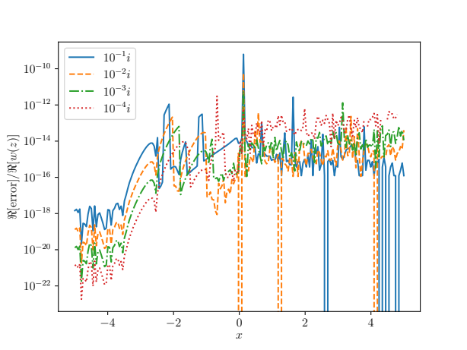
the incomplete faddeeva function
Our numerical methods are detailed in greater depth in the paper, but show we can evaluate w(z, x) with excellent accuracy:
c
c
Above: w(-2.9+c, x) error
Above: w(c, x) error

Slide 83
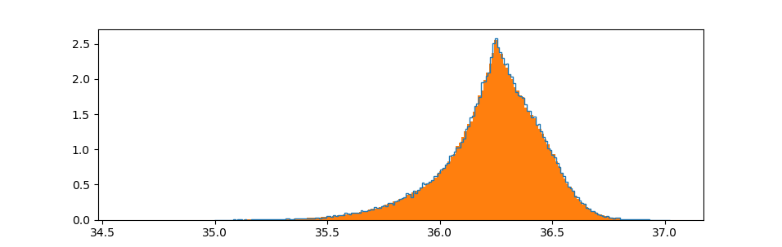
results
With an accurate w(z, x), we can test actual scattering problems
Shown below: 36.25 eV neutron incident on ²³⁸U at 600K
Solid histogram: my result
Dark line: DBRC reference result
p(E)
Energy (eV)

Slide 84
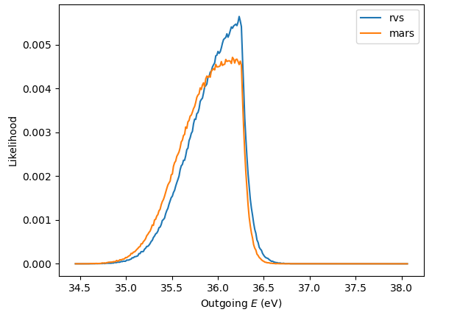
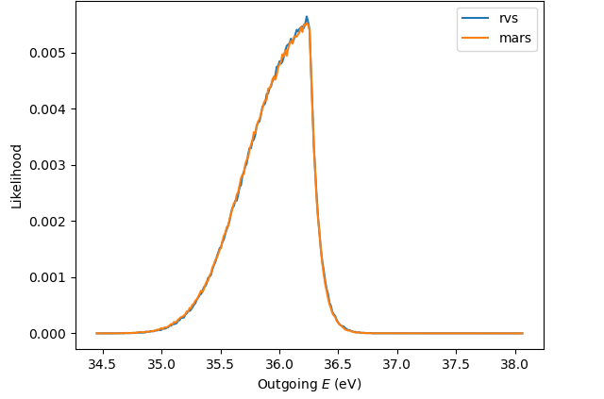
results
Maxwell-Boltzmann distribution does not span multiple resonances for ²³⁸U most of the time, but does for ²³⁵U
This serves as a test of our pole sampling technique
Below left shows an incorrect approach (nearest pole)
36.25 eV incident neutrons, 900K
Above: selecting nearest pole is INCORRECT
Above: pole sampling technique

Slide 85
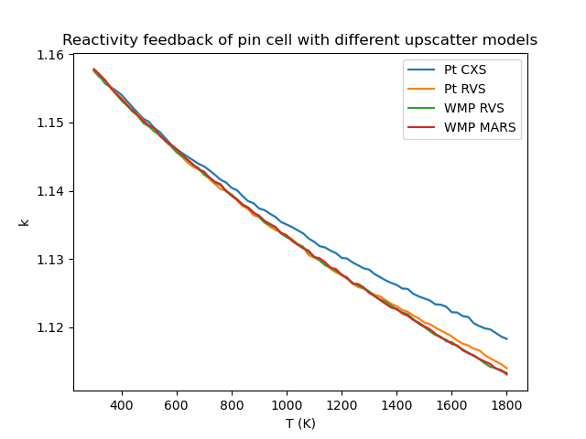
results
Lastly we implemented the method in OpenMC and tested on a 2.4% enriched PWR pin cell
Reactivity was calculated to +/- 5 pcm from 300 to 1800 kelvin using a few resonance upscatter methods
Agrees well with the reference RVS technique

Slide 86
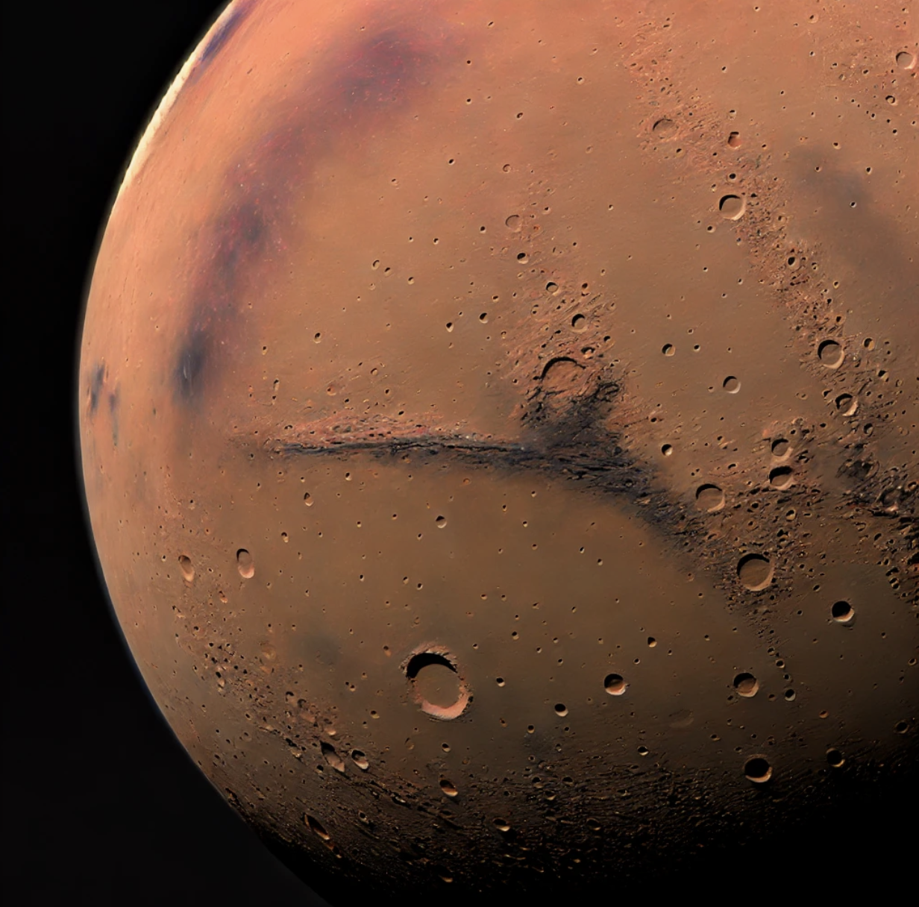
results
The new method induces negligible computational overhead compared to other methods in OpenMC
Shown right is the tracking rate in 10³ particles/second for the same pin cell problem on a laptop
Multipole
Analytic
Resonance
Scattering

Slide 87
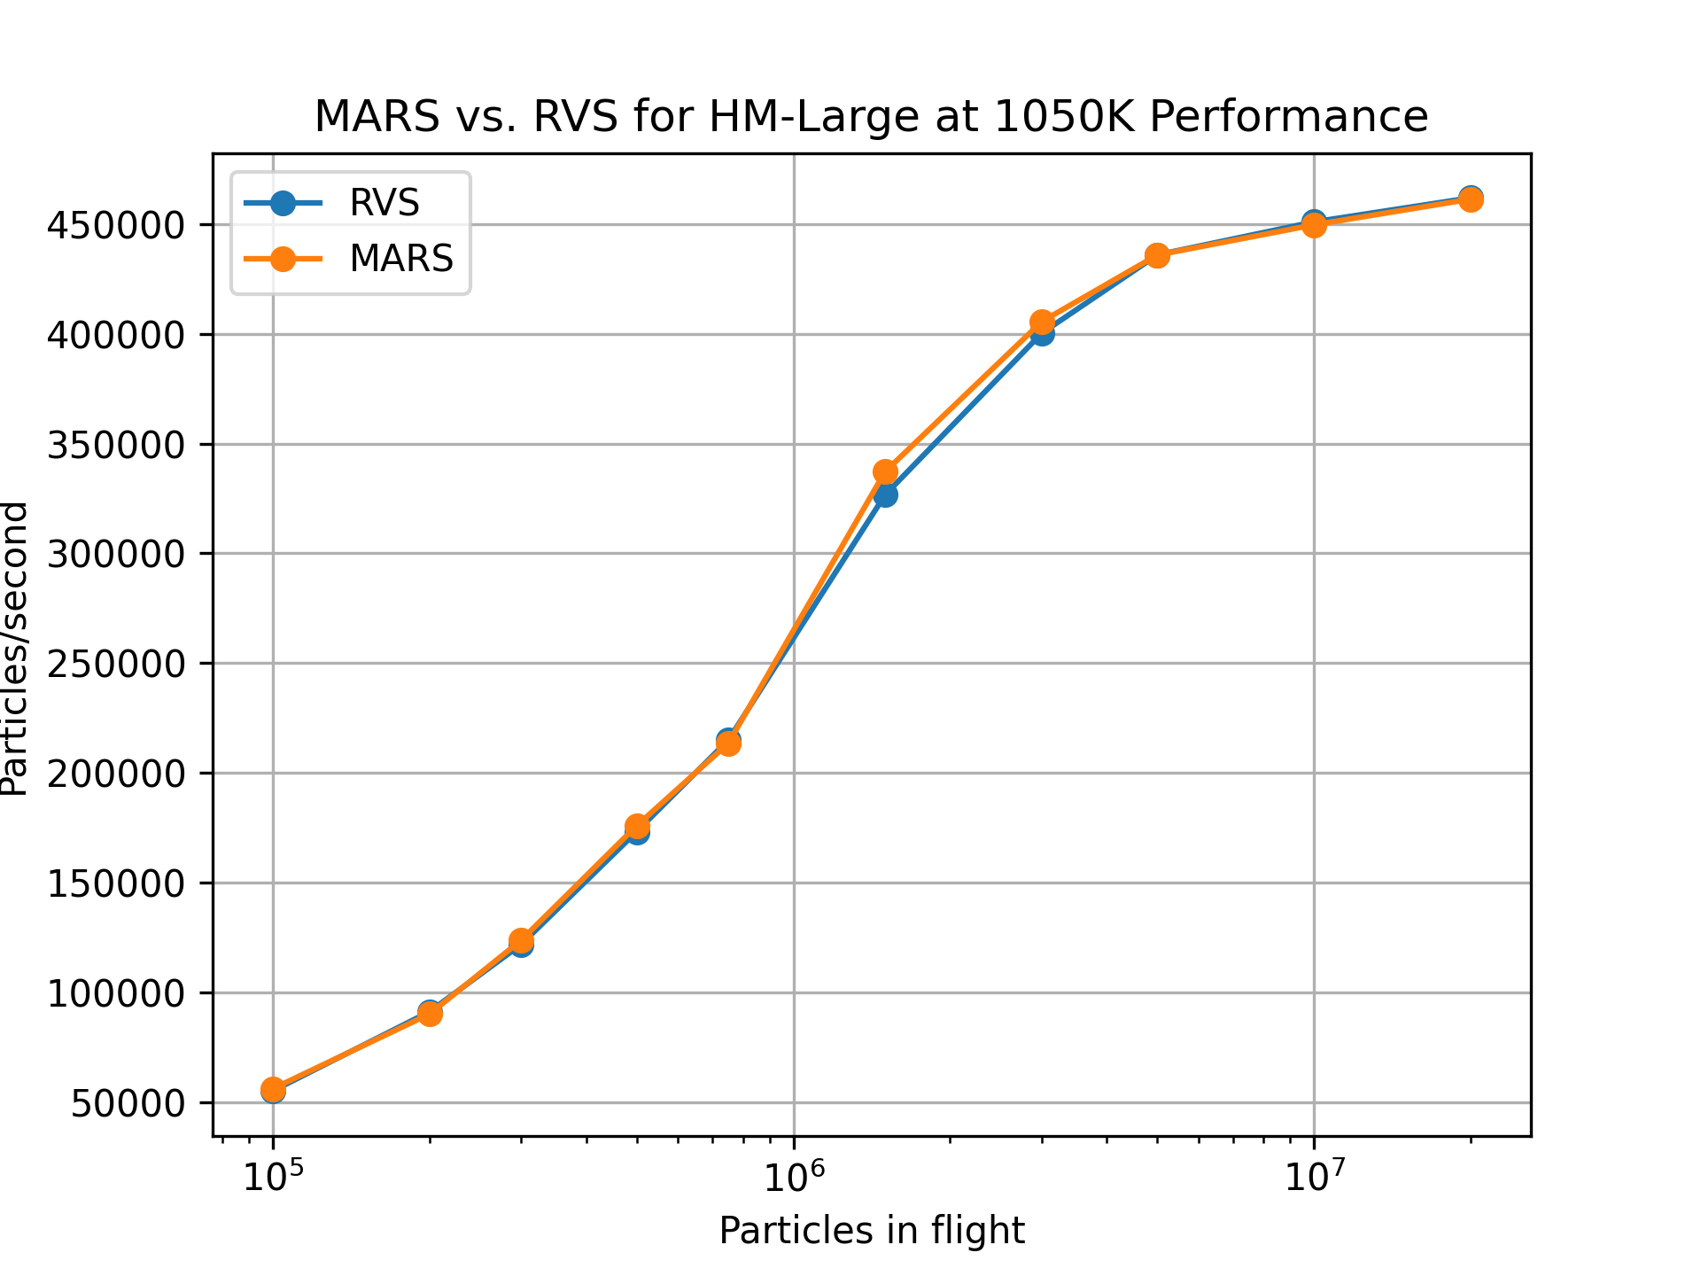
results
H100 GPU
performance
Multipole
Analytic
Resonance
Scattering
Same performance, zero extra data!

Slide 88
results
New method for handling resonance upscatter without rejection sampling or additional tabular data presented, MARS
Journal paper goes into much greater depth:
Ridley, Gavin, Benoit Forget, and Timothy Burke. “Resonance Scattering Treatment with the Windowed Multipole Formalism.” Nuclear Science and Engineering (May 25, 2023)
Method shows no performance overhead compared to other techniques on CPU/GPU, and matches DBRC/RVS/RST results
https://github.com/gridley/openmc/tree/mars

Slide 89
Suggestions
We removed all pointwise grids; make the world run on multipole.
Far better performance likely possible with optimized/unified collision formalism.
Enables embedded UQ methods.
w(z, x) approximation can likely be improved compared to the current methods.
Tabular w(z, x) is likely performant, too.
Greatest hope is that w(z, x) can be identified elsewhere.

Slide 90
part four
beyond probability tables

Slide 91
part 4 overview
The unresolved resonance region (URR)
Performance impact of URR in GPU MC calcs
My novel theoretical insights about the URR
New method (Analytic Unresolved Resonance Alg.)
Benchmarking
GPU performance
Then we’re done... hang in there!

Slide 92
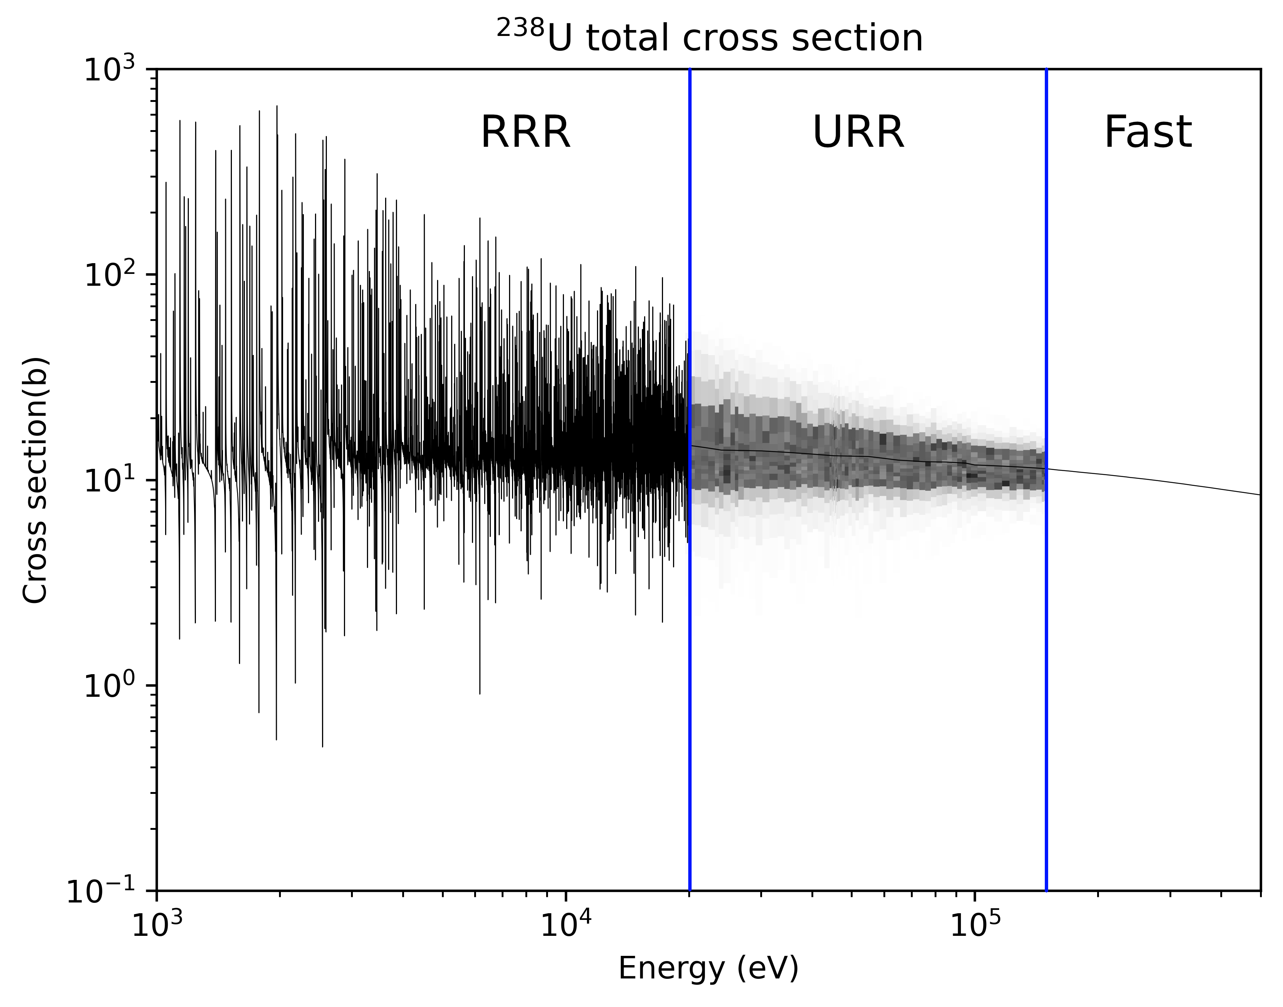
the unresolved resonance region (URR)
Beyond a certain point, we can’t map out the structure of resonances
  (We probably don’t need to anyway)
This was not implemented in MCNP until the 1990s*
Tends to increase the value of k by about 0.1%
Temperature effect? 🤷‍♂️
* R. D. Mosteller and R. C. Little, “Impact of MCNP Unresolved Resonance Probability- Table Treatment on Uranium and Plutonium Benchmarks,” Los Alamos National Lab. (LANL), Los Alamos, NM (United States), Tech. Rep. LA-UR-99-2300, Sep. 1999.

Slide 93
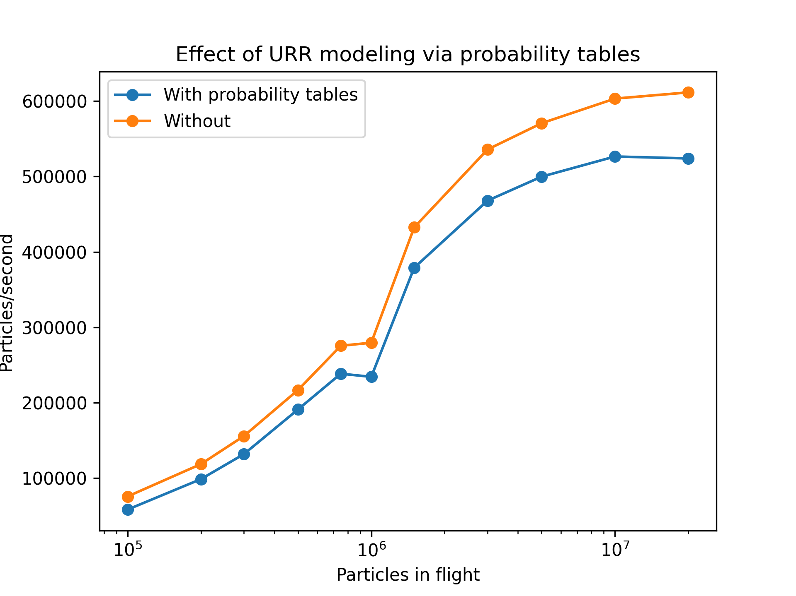
pertinence to the context
URR modeling is done with probability tables
This was shown to incur a 20% performance penalty on HM-Large by Tramm et al.*
  Probably worse in depleted fast reactors
My version of GPU OpenMC presents the same result on the H100 GPU
We can model the URR differently to avoid the penalty
Above: tracking rate on HM-large w/ and w/o ptables
* J. Tramm, P. Romano, J. Doerfert, A. Lund, P. Shriwise, A. Siegel, G. Ridley, and A. Pastrello, “Toward Portable GPU Acceleration of the OpenMC Monte Carlo Particle Transport Code,” PHYSOR 2022 .

Slide 94

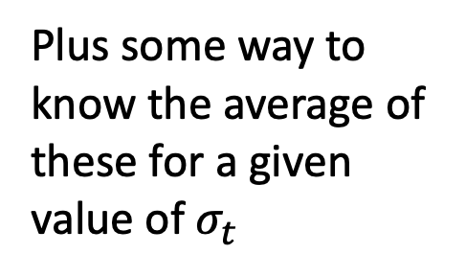
probability tables
URR modeling is done with probability tables
These are
  A tabulation of the CDF of the total microscopic cross-section about an energy in the URR range, plus
  Tabulation of the conditional expectation of the partial cross-section components conditioned on the total cross-section
Typically use 20 tabulation points
Distribution of this
$$σ_{t}= σ_{γ}+σ_{s}+σ_{f}$$
Plus some way to know the average of these for a given value of $σ_{t}$
* J. Tramm, P. Romano, J. Doerfert, A. Lund, P. Shriwise, A. Siegel, G. Ridley, and A. Pastrello, “Toward Portable GPU Acceleration of the OpenMC Monte Carlo Particle Transport Code,” PHYSOR 2022 .

Slide 95
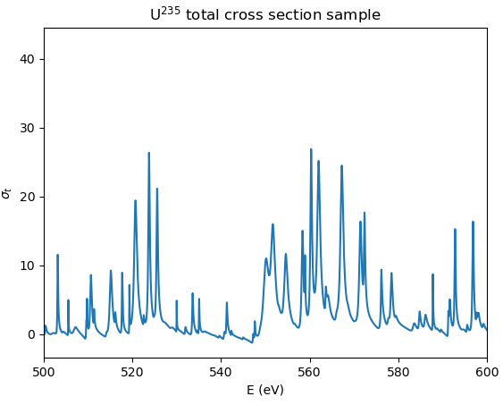
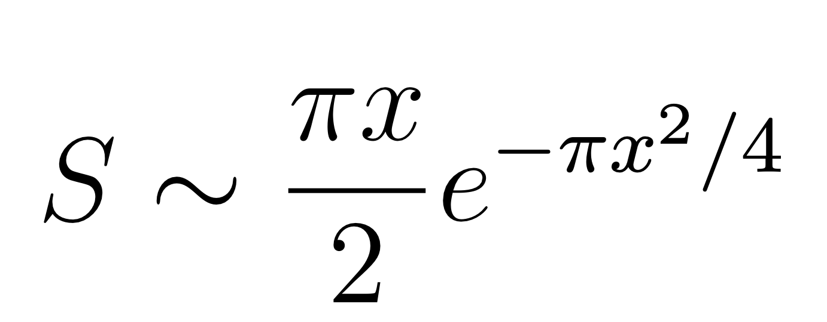
how to make probability tables?
We know some basic physical features that resonances have
  Width functions are χ² random variables
  Resonance spacing is Rayleigh-distributed (random matrix theory)
Different spin states are statistically independent
Normalized spacing distribution:
Above: example of s wave contribution to the ²³⁵U total cross-section distribution (zero kelvin)

Slide 96

what can we do?
Our original thinking: do something like windowed multipole, then fit external behavior with normal distributions or something else simple
I found that fitting the summed component is ill-posed without regularization (optimal deconvolution)
The table lookup to sample URR data is what kills GPU performance
If we can find an analytical model of URR behavior, we can probably
  1) Improve modeling fidelity
  2) Make the calculation run faster on GPUs
When I dug into it, I discovered something far more fundamental.

Slide 97

early attempt at the problem
After trying the windowed-type approach with direct resonance sampling, I realized that this approach would fully model the joint distribution of the partial cross-sections
This has conventionally been neglected!
Who thinks it matters?

Slide 98

early attempt at the problem
Common sense approach first: fit multivariate log-normal distributions via maximum likelihood
This provided lackluster results.
Interesting: can you see the paths traced out by sampling?

Slide 99

my first novel contribution on urr
I have rigorously proved, for the first time, that the steady-state transport equation does not care about the full joint cross-section distribution.
Treat cross-sections as general correlated random variables, apply probability rules correctly to the whole equation.

Slide 100

my first novel contribution on urr
Take the expectation value of the whole thing. Linearity of expectation lets us go term-by-term. Firstly, streaming is easy!

Slide 101


my first novel contribution on urr
Then we can handle the attenuation term. This requires the trick:
Univariate expectation
This is the unknown we solve for
Multivariate expectation

Slide 102

my first novel contribution on urr
The source term requires no special care. On the other hand, handling scattering is nontrivial:
We need this data

Slide 103
my first novel contribution on urr
What assumptions were required to go through that?
Neglect correlation between nuclide-wise cross-section components at a given E
Neglect correlations between two energies (narrow resonance apprx.)
Particles do not return to energies from whence they came (correlation)
To my knowledge, no other researcher has demonstrated explicitly that we can reduce the random cross-section problem in the URR to a univariate modeling problem.
With this theory, we now know what to focus on.

Slide 104




my second novel contribution on urr
Next I carried out a numerical study to see the distribution of $σ_{t}.$

Slide 105


my second novel contribution on urr
Next I carried out a numerical study to see the distribution of $σ_{t}.$
Case 1
Case 8

Slide 106
my second novel contribution on urr
Now is when I will blow your mind. 🤯
Through a few approximations we can:
Analytically calculate the cross-section distribution at wide spacings
Predict the tail behavior at intermediate resonance spacings
Predict the distribution behavior at tight resonance spacings
Let’s hit the first one.

Slide 107



my second novel contribution on urr
We can write the total cross-section as:
Now we take the spacings to be uniform and equal to the average. There is a theorem that justifies this.

Slide 108



my second novel contribution on urr
Note that the summation terms can be written as complex numbers.
This gets rid of the quadratic energy dependence.
Now, we use the most beautiful, under-appreciated formula in mathematics:
Now carry the Re[...] operator through the summation to find:

Slide 109

my second novel contribution on urr
Now we can expand out the Re[] operator to find:
For widely spaced resonances we have that:

Slide 110

my second novel contribution on urr
Now we can expand out the Re[] operator, and analytically compute the cross-section distribution. Applying a few other judicious approximations, I present the crown jewel result of my Ph. D. thesis:

Slide 111

my second novel contribution on urr
Let’s check how accurate this is (right).
This is predictive. I did no curve fitting.

Slide 112


my second novel contribution on urr
Another cool but less useful result: widely spaced p wave resonances follow a -3/2 power law:

Slide 113
my second novel contribution on urr
This leads us to our first constraint for an analytical model of the cross-section distribution:
1) It must be able to closely approximate a Cauchy distribution.
See the thesis for details, but analysis of the intermediate and wide resonance cases gives you that:
2) It must be able to have tails that are linear in log space (previously noted by Hwang*)
3) It must be able to approximate a Gaussian

Slide 114

my second novel contribution on urr
This is easy!
Barndorff-Nielsen INVENTED the hyperbolic distribution in 1978 to model the probability distribution of wind-blown sand grain sizes in log-log space.
This exactly satisfies criterion #2.
“Low diffusion coefficient from math to applications”
Source: Hwang 1987
O. Barndorff-Nielsen, “Hyperbolic distributions and distributions on hyperbolae,” Scandinavian Journal of Statistics, vol. 5, no. 3, pp. 151–157, 1978,

Slide 115

my second novel contribution on urr
Barndorff-Nielsen on wind-blown sands
Hwang 1987

Slide 116


my second novel contribution on urr
Barndorff-Nielsen later generalized the hyperbolic to the generalized inverse Gaussian (GIG) family.
One member, the normal inverse Gaussian (NIG) has the Cauchy approximation property.
It can also approximate a Gaussian*.
O. E. Barndorff-Nielsen, “Normal Inverse Gaussian Distributions and Stochastic Volatility Modelling,” Scandinavian Journal of Statistics, vol. 24, no. 1, pp. 1–13, 1997

Slide 117


my second novel contribution on urr

Slide 118


my second novel contribution on urr
The mixture distribution property lets us devise a VERY efficient sampling method.
Works excellently on a GPU.
Notes:
I like to think of this one like making a nuclear bomb. All the info is out there on how to do it, but you need to just put the pieces together yourself.

Slide 119
my second novel contribution on urr
Lastly let’s test the idea.
Generated a full super-resolved URR library, generated with an in-house GPU-accelerated PURR ripoff.
Fit to all nuclides at each energy/temperature.
Minimize Hellinger distance (better than Kullbach-Liebler)
Notes:
I like to think of this one like making a nuclear bomb. All the info is out there on how to do it, but you need to just put the pieces together yourself.

Slide 120

my second novel contribution on urr
Notes:
I like to think of this one like making a nuclear bomb. All the info is out there on how to do it, but you need to just put the pieces together yourself.

Slide 121

my second novel contribution on urr
Notes:
I like to think of this one like making a nuclear bomb. All the info is out there on how to do it, but you need to just put the pieces together yourself.

Slide 122

my second novel contribution on urr
Notes:
I like to think of this one like making a nuclear bomb. All the info is out there on how to do it, but you need to just put the pieces together yourself.

Slide 123

my second novel contribution on urr

Slide 124

my second novel contribution on urr

Slide 125

my second novel contribution on urr
Not everyone can fit perfectly!

Slide 126

my second novel contribution on urr
R-matrix theory fans should look at this one.

Slide 127


what about the conditional expectations?
Long story short, Hwang showed * these should be rational polynomials
Humanity is FINALLY developing the technology to efficiently use rational polynomial approximations
Barycentric rational forms are king
R. N. Hwang, “Exploration of an analytical model for treating the unresolved reso- nances,” Nuclear Science and Engineering, vol. 167, no. 1, pp. 1–39, Jan. 1, 2011,

Slide 128

Does it go fast on gpus?
yes

Slide 129
is it correct?
I simulated these problems:

Slide 130

is it correct?
Big Ten
Ten tons of alternating intermediate and high enriched uranium!
Right: Sourced from John Walsh’s Ph. D. thesis

Slide 131

is it correct?
ZEBRA-8H
37% enriched uranium sandwiched with uranium metal
Right: sourced from John Walsh’s Ph. D. thesis

Slide 132

is it correct?
SHEBA-II / PNL-10
5% enriched uranyl fluoride aqueous solution
Right: from
LaBauve, R. J., and Sapir, J. L. SHEBA-II as a Criticality Safety Benchmark. United States: N. p., 1995. Web.

Slide 133

is it correct?
ZPR-3/53,6/10
Various configurations of plutonium,
depleted uranium zero power cores
Right: from Argonne National Laboratory Youtube channel

Slide 134

is it correct?
yes
Note: mean of the distribution is normalized against the pointwise grid
(nuclear data shortcoming, not for this method)

Slide 135

experimental implications: big
Neutron attenuation through a sample can be analytically calculated assuming it is NIG-distributed
This lets us directly fit 4 parameters to transmission experiment data—no need for intermediate unknowns
WAY better than probability tables

Slide 136
my final thoughts
Stop caring if Monte Carlo is slow
  We should develop robust, generally applicable deterministic methods
  The community is making headway on continuous energy deterministic code
  GPU Monte Carlo is like herding cats. GPU deterministic solvers can map to already highly-optimized subroutines.
  Monte Carlo should be the method of last resort!
(Opinion) Many deterministic codes have remained practically useless due to not using characteristics-based techniques
  This has led people to conclusions
  Restriction to Cartesian mesh + lack of good meshing methods
More research on GPU rejection sampling (why is RVS not bad?)
      There might be a “phase change” like behavior / threshold for randomly distributed rejection rates.

Slide 137

THANK YOU
gavin@aalo.com

Slide 138

other plots of potential interest

Slide 139

other plots of potential interest

Slide 140

other plots of potential interest

Slide 141

other plots of potential interest

Slide 142

other plots of potential interest

Slide 143

other plots of potential interest

Slide 144

other plots of potential interest

Slide 145

complexity of double-differential collision distributions

Slide 146


complexity of double-differential collision distributions

Slide 147
backup slide #1
Tallies are outside the
scope of this work.

Slide 148
part 5 😱 gpu rejection sampling

Slide 149

rejection sampling on gpu
Finally, I can share with you my first contribution! This will be the continued theme through the remainder of the talk.
What happens if threads each must find a sample via rejection?
Above: rejection sampling can be used to sample from probability distributions that can be bounded above.
Ridley, Gavin, and Benoit Forget. “A Simple Method for Rejection Sampling Efficiency Improvement on SIMT Architectures.” Statistics and Computing 31, no. 3.

Slide 150

Sample proposals from this uniform distribution

Slide 151
To find samples from this triangular distribution

Slide 152
To find samples from this triangular distribution

Slide 153
To find samples from this triangular distribution

Slide 154
To find samples from this triangular distribution

Slide 155

To find samples from this triangular distribution

Slide 156

rejection sampling on gpu
My question: what happens to code performance when we have to wait for all threads to finish looking for a sample?
There is a fixed probability of not finding an accepted sample at each step, the rejection probability ⍴.
We know in the single thread case that the number of attempts follows a geometric distribution.
Above: examples of the geometric distribution.

Slide 157

rejection sampling on gpu
My initial analysis of the problem: treat the number of loops as a Markov chain.
32 threads running:
1 threads running:

Slide 158


rejection sampling on gpu
The probability of k rejections happening among t threads with rejection probability ⍴:
We know the distribution of thread count in the next iteration if we know it at the present one.
k rejections
t active threads

Slide 159




rejection sampling on gpu
Suppose:
This implies:
We have that:
Applying induction using the above:

Slide 160


rejection sampling on gpu
We can now compute the probability of the calculation finishing in a given number of iterations:

Slide 161


rejection sampling on gpu
Plotted probability distribution of rejection count distribution at a 50% rejection probability
Transition from monotonic to unimodal probability distribution happens when:

Slide 162

rejection sampling on gpu
We now apply an approximation to estimate the average amount of time taken when the number of threads t is relevant to what GPUs use (>32)
Without this approximation, the average is a 323rd order rational polynomial!
Average number of iterations:

Slide 163

rejection sampling on gpu
Let’s check how accurate this formula is
Wrote GPU rejection sampling mini-app (t = 32)
Measured mean and standard deviation iteration count per warp
Average number of iterations:

Slide 164
resonance upscatter
Quintessential resonance upscatter sampling algorithm:
  Doppler broadening rejection correction*
Suppose that is a probability distribution for X, Y, and ,
and anywhere that .
If we sample X, Y from and accept it with probability :
Benefits:
  No need for normalizing constant
  f may be easy to sample, but not
* Ely M. Gelbard. Epithermal Scattering in VIM. FRA-TM-123. Argonne, IL, United States:
Argonne National Laboratory, Dec. 5, 1979.

Slide 165
resonance upscatter
Quintessential resonance upscatter sampling algorithm:
  Doppler broadening rejection correction
The bivariate distribution we wish to sample is:

Slide 166

the incomplete faddeeva function
How did I find this identity? Underpins efficient numerical method.
Incomplete Faddeeva:
First define:

Slide 167


the incomplete faddeeva function
Complex line integral theorem:
Use that definition of F(z), then compute the integrand:

Slide 168

the incomplete faddeeva function
Complex line integral theorem:
We then obtain this identity:

Slide 169

the incomplete faddeeva function
Identify a pole-less contour, change the segment we’re integrating on:

Slide 170

the incomplete faddeeva function
Identify a pole-less contour, change the segment we’re integrating on.
This leg of it let’s us cancel the exponential integral:
This gives us the desired result connecting w(z, x) and w(z):
Now this is all we have to deal with. How?

Slide 171


the incomplete faddeeva function
Long story short, we can reduce the remaining problem to computing:
Which has a really cool connection to the Dawson F function:

Slide 172


the incomplete faddeeva function
Long story short, we can reduce the remaining problem to computing:
We can reformulate it via Feynman integration:
Which lets us insert a standard polynomial approximation for F(z):

Slide 173



the incomplete faddeeva function
Beware, lots of other thorny details remain. For example, error for the exponential integral recurrence relation is:
You can invert it by recursing forward or backward. This leads to the coolest equation in my whole thesis:
On par with this one?

